Slide 1
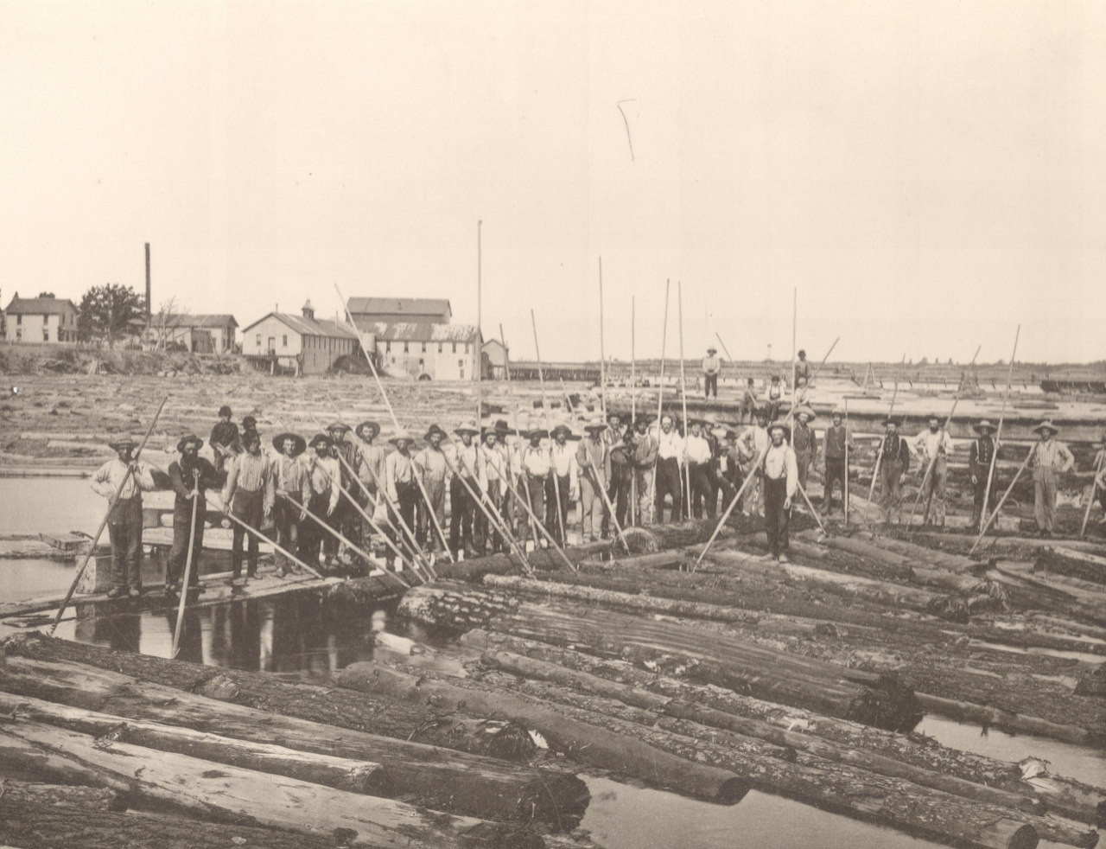

City of Marinette
Historic Preservation Plan
April 2013

Slide 2
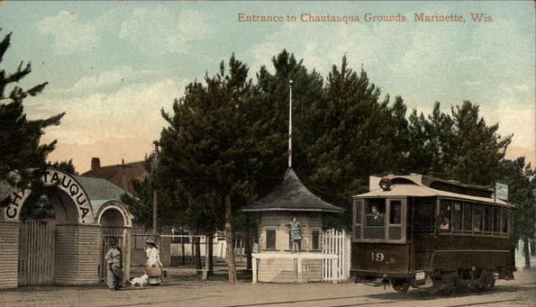
Table of Contents
Executive Summary 2
Why Preserve 3
Goals of Historic Preservation in Marinette 4
Marinette’s Historic Character 5
History of Marinette 7
Preservation Law 11
  - Marinette vs. Menominee 12
A Brief History of Historic Preservation in Marinette 13
  - Proposed Main Street Historic District 18
  - Proposed Hall Avenue Historic District 20
  - Proposed Riverside Avenue Historic District 22
  - Proposed Stephenson Street Historic District 24
Marinette’s Designated Historic Landmarks 25
Recent Preservation Issues 26
Incentives for Historic Preservation 27
Action Plan 29
Works Consulted 31
Page 1
Background – Postcard view of Chautaqua Grounds, c. 1910

Slide 3
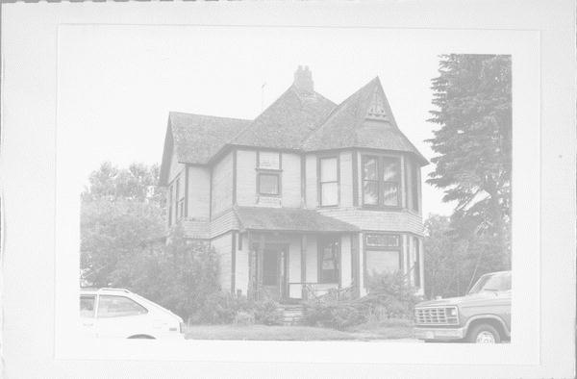
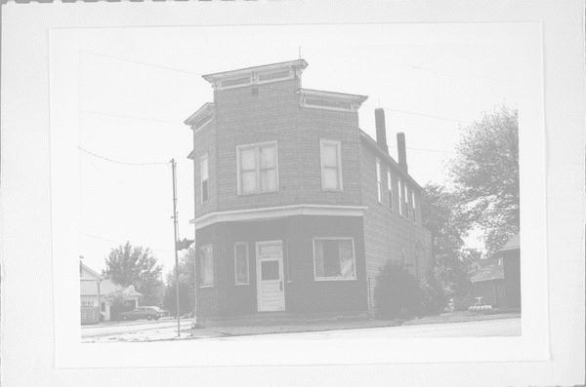
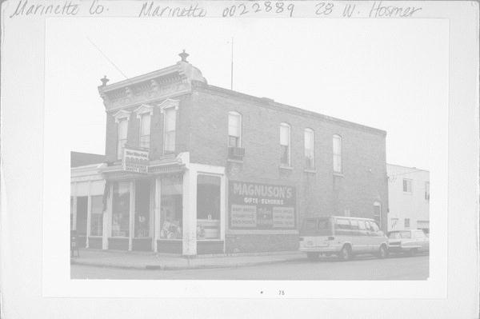
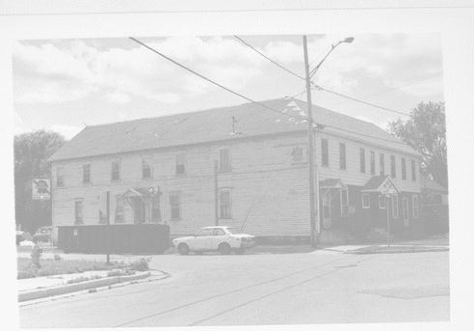
Executive Summary
The purpose of this City of Marinette Historic Preservation Plan is to generate discussion about preservation topics in Marinette. To that end, this plan includes a proposal for actions intended to reinvigorate preservation activities in Marinette and restore focus on preservation objectives set forth as part of a local preservation movement that began following Marinette’s Centennial celebration in 1987.
The benefits of preservation are widely acknowledged throughout the country, many of which would offer aesthetic and economic value to not only Marinette’s historic downtown center but also the city as a whole. Furthermore, financial incentives are available for owners of both income-producing historic properties and historic homes. Marinette has much to gain from a more proactive approach to historic preservation.
Marinette is fortunate to have the remaining historic resources that it does, but those resources have been steadily disappearing over the last 25 years, often being replaced by a vacant lot. The time to once again consider what historic preservation has to offer Marinette is upon us. Let us start that conversation again and set ourselves on a path that will begin to pay tangible dividends for ourselves and future generations in Marinette.
Background – Menekaunee scenes, Wisconsin State Architecture and History Inventory Photographs, c. 1985, all buildings extant today
Page 2

Slide 4
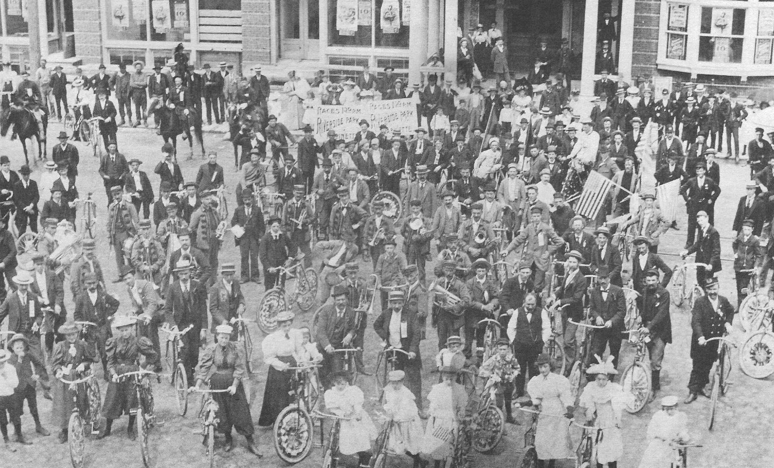
Why Preserve?
Improved Tax Base
Tax dollars are saved through the re-use of buildings served by in-place utilities, roads, and other public services.
Historic District designation may stimulate private investment in an area.
Property values often increase in revitalized areas.
Rehabilitated buildings returned to the tax rolls raise property tax revenue.
Improved Business Climate
Revitalized buildings and historic districts attract new businesses, tourists, and visitors, stimulating retail and increasing sales tax revenue.
Renovation creates new jobs during the construction and later in new offices, shops, restaurants, and tourism activities.
Renovated buildings may command higher rental and sale prices, because of their prestige value.
Advantages of Rehabilitation over New Construction
Less energy is required to rehabilitate existing buildings than to demolish and replace them with comparable new construction, using similar materials.
Rehabilitation is environmentally friendly and promotes reuse.
Reusing old buildings saves demolition costs.
Old buildings can often be acquired for a low price.
Renovation can take less time than new construction and can take place in stages.
Tax advantages are available for rehabilitation and restoration.
The legacy of many a city’s pioneers is embodied in the historic edifices that constitute the bones of the built environment. These historic resources provide a community with a sense of its history, an awareness of its origins, and a distinct image of itself. They provide an important mental and physical continuity, familiarity, and orientation in a world characterized by rapid change. Older buildings and sights contribute to a visual diversity, a human scale, a richness of craftsmanship, and a pleasant association that can enrich our lives.
Marinette’s older commercial and residential districts attest to the city’s history as a lumber and commercial center. The preservation of local historic resources strengthens community pride. Protecting the physical evidence of a community’s character increases citizens’ pride in their neighborhoods and identification with their community.
Beyond the social benefits to a community, there are distinct and measureable economic advantages to the rehabilitation and re-use of historic buildings.
Page 3
Background – Marinette Bicycle Club, c. 1900

Slide 5
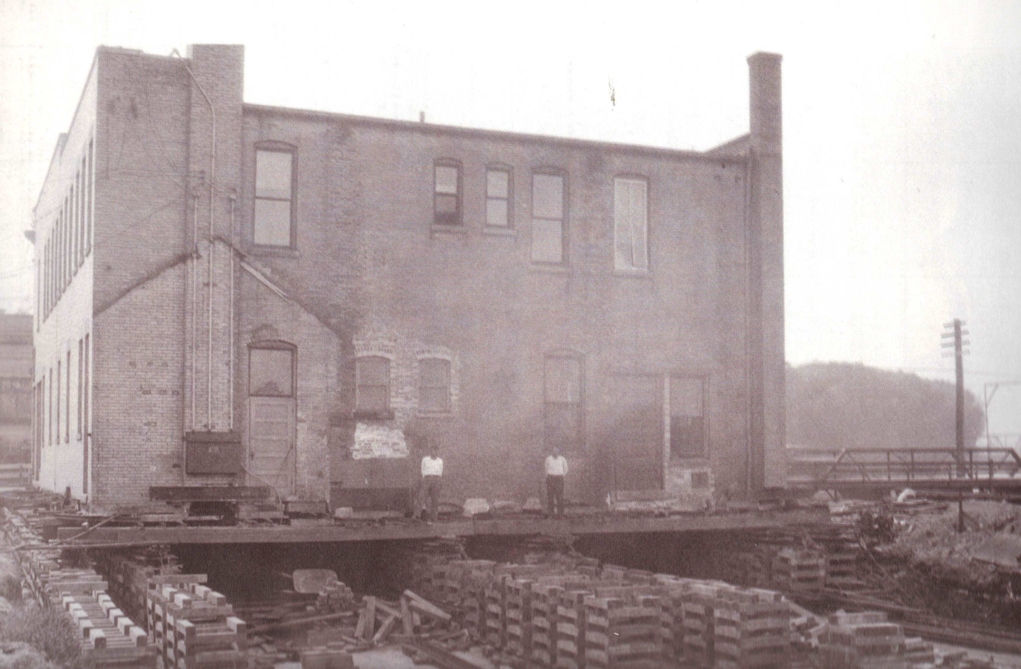
Goals of Historic Preservation in Marinette
To Foster Civic Pride through the recognition of Marinette’s key role in northeast Wisconsin’s history.
To Protect and Maintain Historic Resources through increased awareness of historic preservation and community involvement.
To Enhance the Quality of Life through coordinated efforts by community organizations and property owners to provide heritage programming and aesthetic appreciation.
To Stimulate Economic Development through the restoration of irreplaceable historic buildings that embody Marinette’s unique architectural and cultural heritage.
Background – Moving the Mission Point building, 1928
Page 4

Slide 6
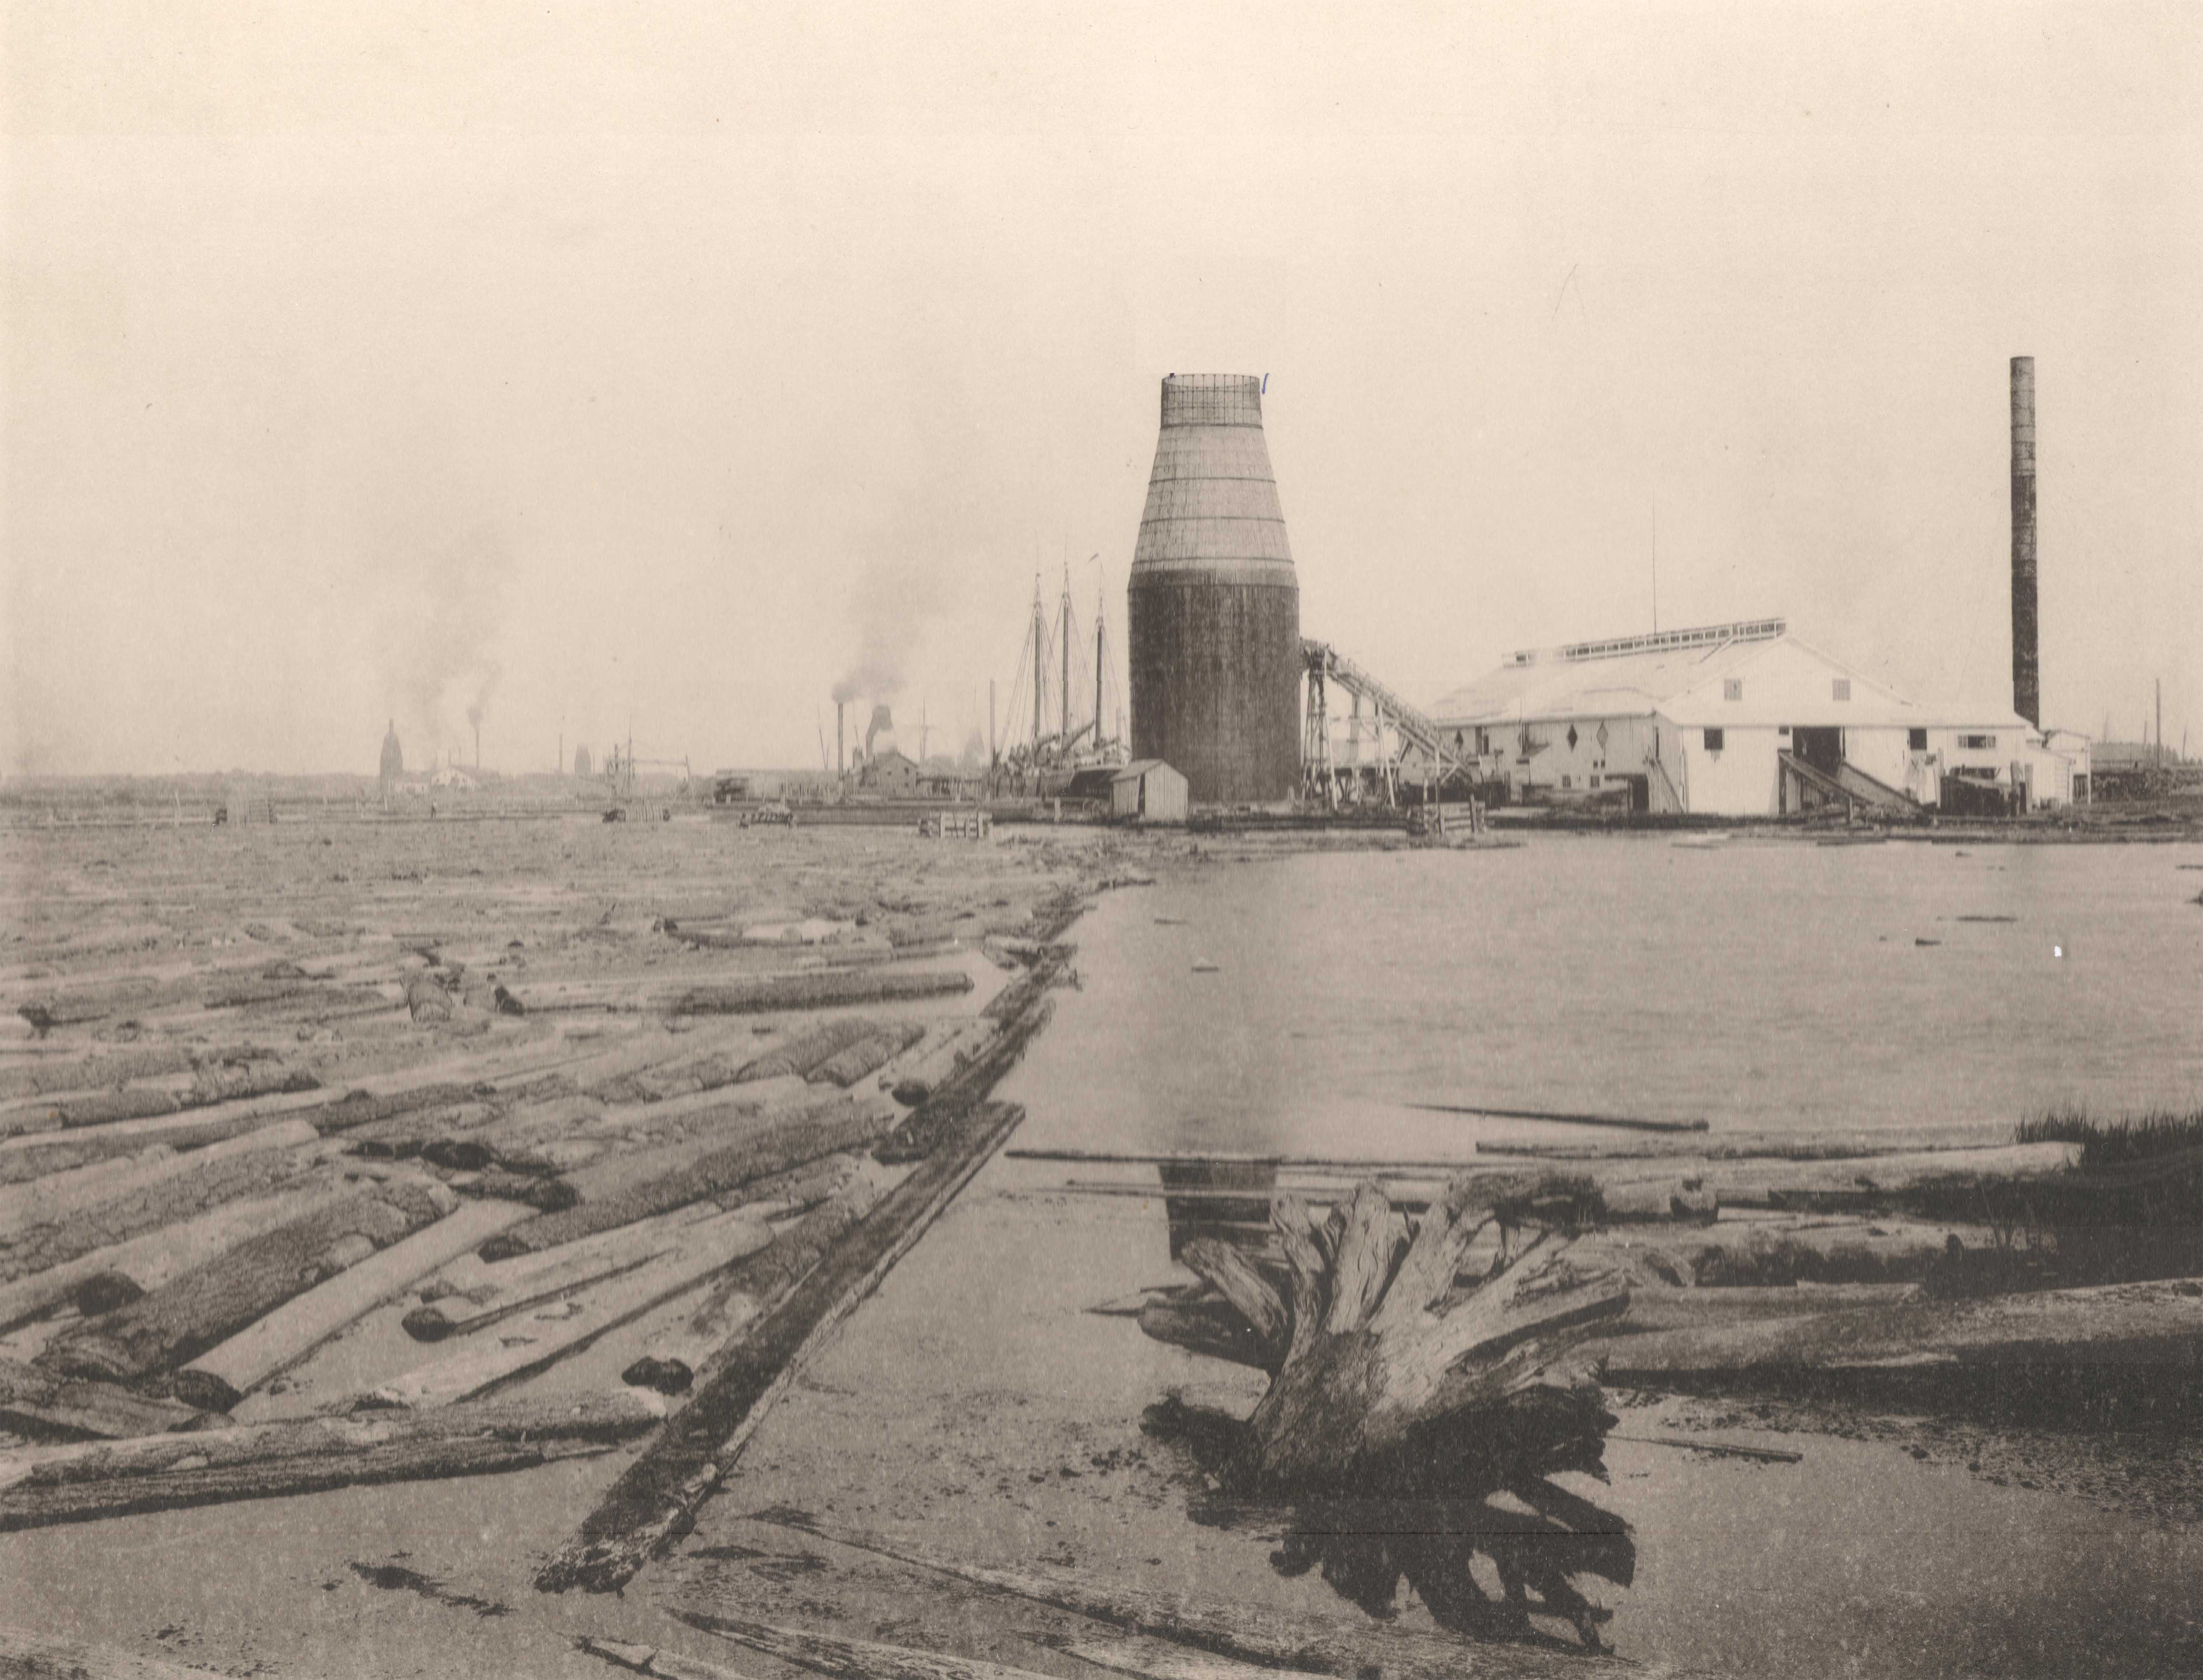
Marinette’s Historic Character
The City of Marinette began as an Indian settlement that initially gained importance in the late 18th century as a fur trading outpost. This era gave way to the age of lumber beginning in the 1830s. The lumber industry effectively ended in the 1930s, giving way to today’s emphasis on a manufacturing based economy.
No buildings or structures remain from Marinette’s past as an Indian settlement or fur trading outpost; however, archaeological remnants of an Indian camp, village, and various cemetery sites are located within the present-day boundaries of the city.
No industrial mill buildings remain from Marinette’s lumber industry. As the industry declined, the mills were razed, dismantled, or not rebuilt following their destruction by fire. Other buildings from the logging era are abundant and define much of the architectural character of the city. Marinette’s traditional downtown commercial center reflects the architectural tastes predominant during the city’s boom years of 1880 to 1910.
Page 5
Background – River view and Isaac Stephenson Mill on Stephenson Island, 1887

Slide 7
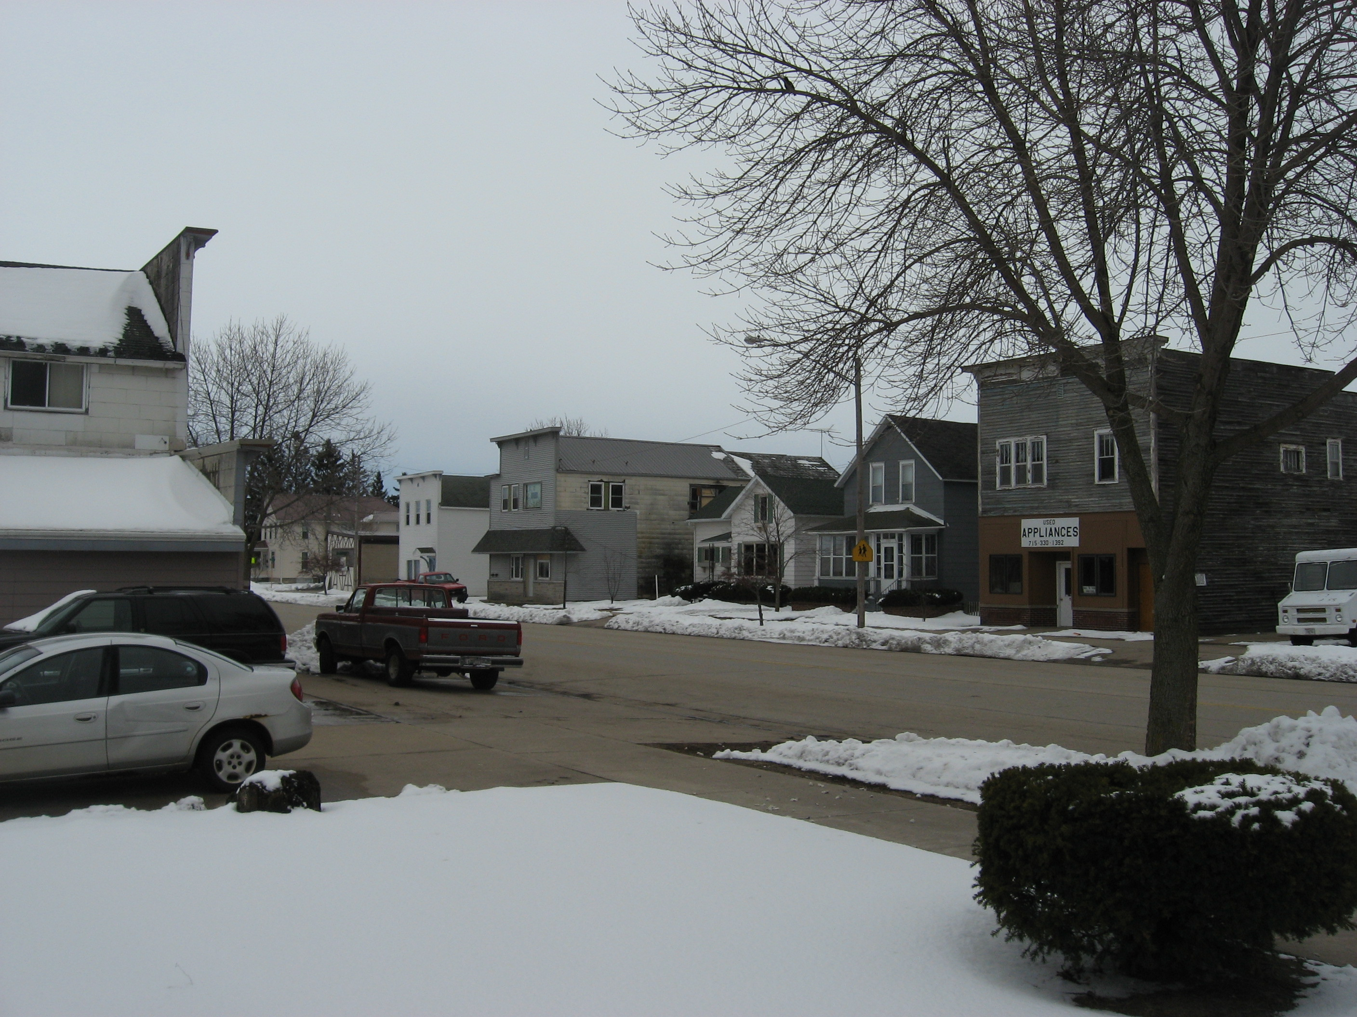
Due to the lack of population growth in the 20th century, Marinette has relatively few new residential areas. The majority of the housing dates from before 1930. These older houses are predominantly wood frame, gable roof, and vernacular in style, often with some Italianate influence. Common vernacular forms include one- and two-story, gabled ell or front gabled styles with bracketed bay or Italianate window hoods. In addition to the vernacular styles, Marinette also has one or more examples of Italianate, Shingle Style, Queen Anne, Colonial Revival, Neo-Classical, Chicago Commercial, Prairie School, Arts and Crafts, American Craftsman, American Foursquare, Bungalow, Georgian Revival, Tudor, Neo-Gothic, Collegiate Gothic, Spanish Colonial, International Style architecture, as well as clusters of wood “boomtown” (false front) commercial buildings.
A common feature of Marinette houses is a limestone or granite foundation. The limestone most likely originated in quarries near Sturgeon Bay, across Green Bay in Door County, whereas the granite came predominantly from quarries near Amberg in north-central Marinette county.
Background – Boomtown architecture near 700 block of Main Street today
Page 6

Slide 8
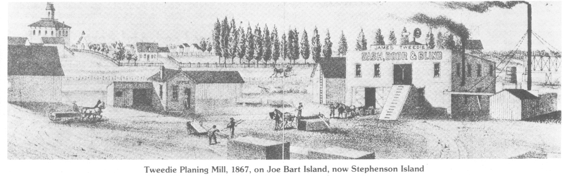
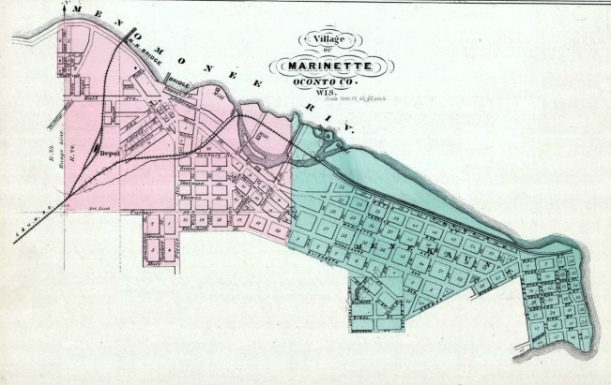
History of Marinette
Menominee Indians were the first permanent settlers of the Marinette and Menominee area. These inhabitants came into contact with French explorers, fur traders, and missionaries in the mid-1600s. The first white settler, Stanislaus Chappu (or Chappee), arrived in 1790 as an agent of the American Fur Company and operated a trading post until 1824. That year, Chappu got into a fight with an Indian and had three Indians imprisoned and taken to Green Bay. William Farnsworth, a rival of Chappu, interceded on behalf of the imprisoned Indians, securing their release and their gratitude. Subsequently, the American Fur Company gave Farnsworth permission to evict and replace Chappu as Farnsworth was on better terms with the native trading partners. Farnsworth would continue to operate the trading post with his common-law wife, Marinette, the granddaughter of a Menominee chief and daughter of a French fur trader. “Queen” Marinette, as she would later be known, is the namesake for the city and county.
As fur trading declined in the 1830s, the lumber trade began to grow to meet the demand of fast-growing cities like Milwaukee and Chicago. Marinette’s first sawmill was built in 1832. Between 1857 and 1867, the four sawmills that would dominate the local lumber industry for the remainder of the century would begin production. Those mills were the New York Lumber Company, the Nelson Ludington Company, the Henry Witbeck Lumber Company, and the Hamilton and Merryman Company. By 1886 there were seven mills on the Marinette side of the river—eventually there would be nine large mills in Marinette and another eleven on the Michigan side of the river . The town of Marinette would evolve primarily from the cluster of buildings that surrounded the Nelson Ludington sawmill while Menekaunee, now Marinette’s East End, would grow around the New York Lumber Company’s mill. A road from Green Bay to Marinette was completed in 1854 and the Northwestern Railroad arrived in 1871; both improved contact with the rest of Wisconsin. Additionally, the Nelson Ludington Company built a bridge across the Menominee River in 1862, thereby improving access between the twin cities. Downtown Marinette grew around this convergence of the road, railroad, and interstate bridge, enabling the city to become the commercial hub of the Menominee River region. The town of Marinette was incorporated as a city in 1887. Marinette is also the county seat of Marinette County, the county having been formed in 1879 when it was set off from portions of Oconto County.
Page 7

Slide 9
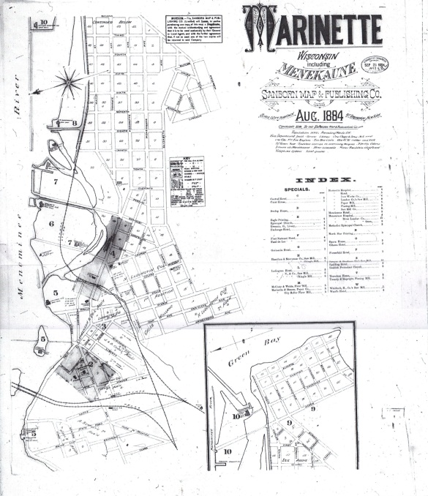
The 1860 census records 489 people living in the combined villages of Marinette and Menekaunee (now part of Marinette). Between 1870 and 1875 the population grew from 1,300 to 2,500 and, by 1880, the population reached 4,024. Newspapers of the time mention a serious housing shortage. The 1880s proved to be a decade of prosperity and growth for Marinette—the population grew to some 11,000 by 1890. The population peaked in 1900 at a little over 16,000, making Marinette the tenth largest city in Wisconsin. The lumber boom had peaked, however, around 1895 and the industry began a slow decline until the last log drive on the Menominee River in 1917 and the closing of the last of the sawmills in 1931.
In the years since the end of the lumber industry, Marinette has diversified its economic base, but is heavily reliant on manufacturing. For the county as a whole, the manufacturing sector accounts for nearly 40% of the total payroll, followed by education & health, which account for 25% of the total payroll. All of the county’s biggest employers are located in the City of Marinette. Several are located on the former lumber mill sites along the shore of the Menominee River.
Page 8

Slide 10
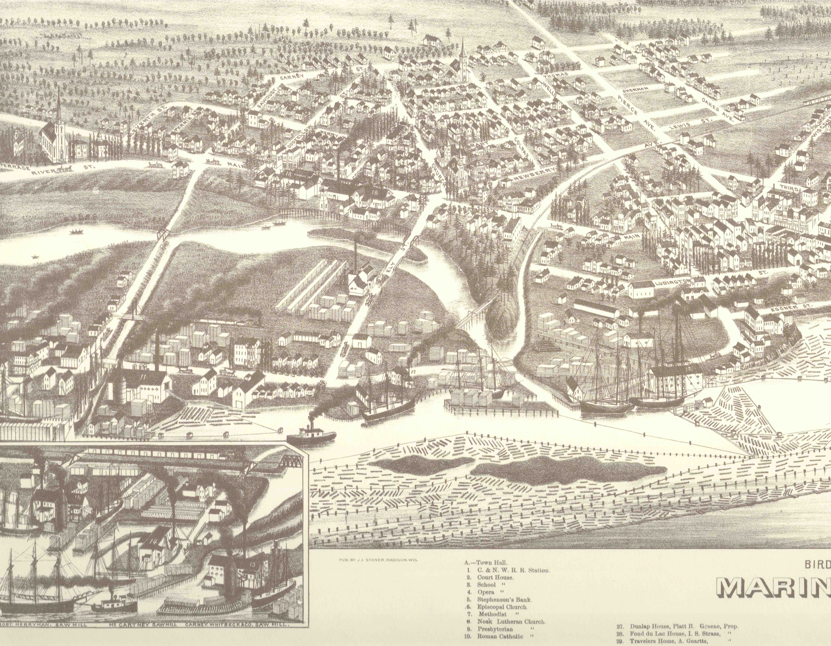
Marinette became the commercial center for the Menominee River region for a number of reasons. Marinette’s business district grew at a central location where the state road, the railroad, and the first bridge crossing the Menominee River all converged. By contrast, neighboring Menominee, Michigan, was built facing the bay of Green Bay on the lower part of the peninsula, away from major avenues of traffic. Beyond location, Marinette benefitted from Wisconsin’s lack of a state sales tax. Furthermore, three of Marinette’s major lumber mills had local partners who showed interest in developing the community. The Nelson Ludington Lumber Company built the first bridge across the Menominee River and Isaac Stephenson, owner of the Nelson Ludington Lumber Company, personally developed much of downtown Marinette. The Marinette Businessmen’s Association, which later became the Downtown Development Club, also proved to be a strong driver of local improvements.
Page 9

Slide 11
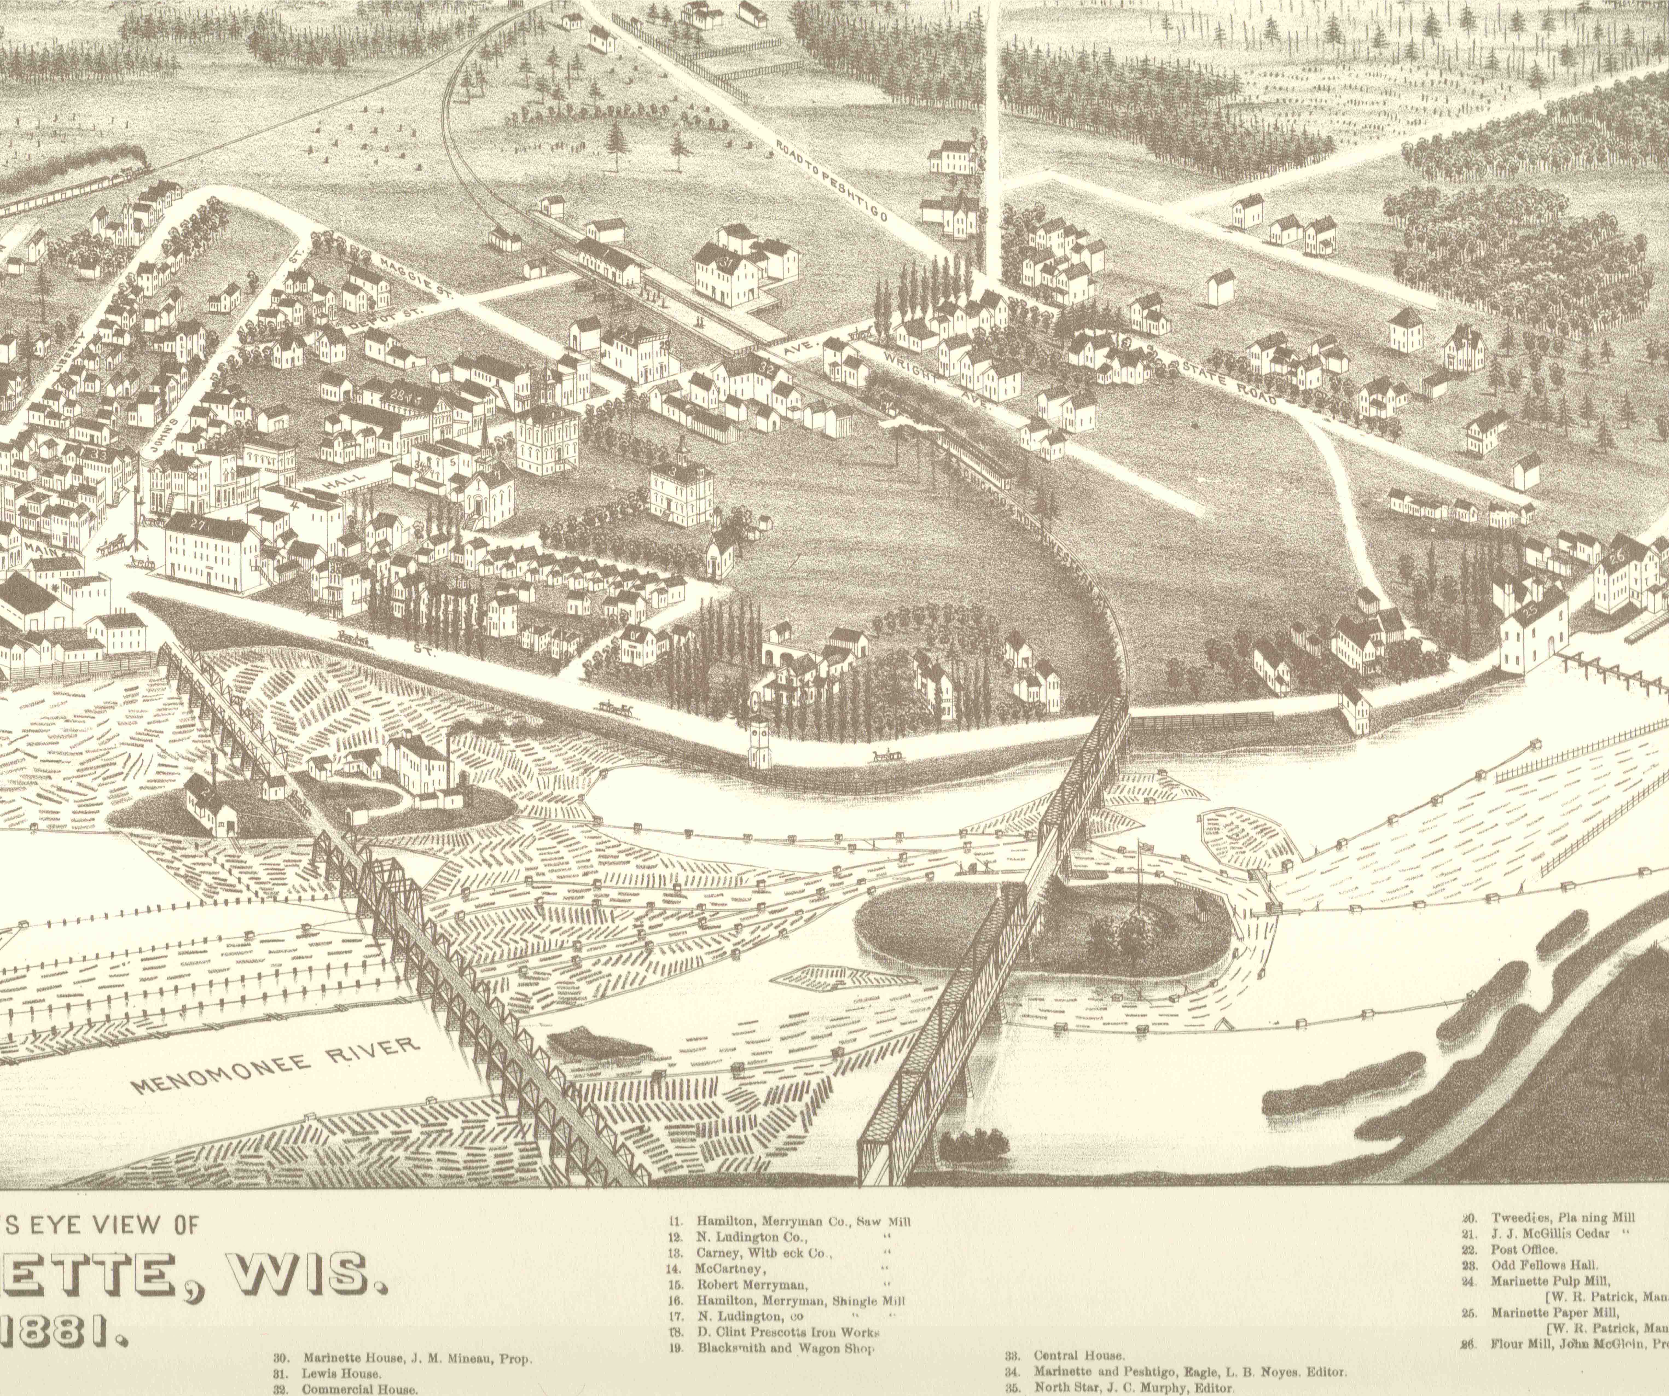
Early Marinette had two major streets. Main Street runs northeasterly between downtown Marinette and what was Menekaunee, now Marinette’s East End. Hall Avenue runs west from Marinette’s downtown and roughly follows the original state road, completed in 1855, which was the first land route connecting Marinette with the rest of Wisconsin. Downtown Marinette grew around Dunlap Square. Here intersect Main, Stephenson, and Dunlap Streets, Hall Avenue, and the bridge crossing the Menominee River. This crossroads became the commercial center for the Menominee River region.
Page 10

Slide 12
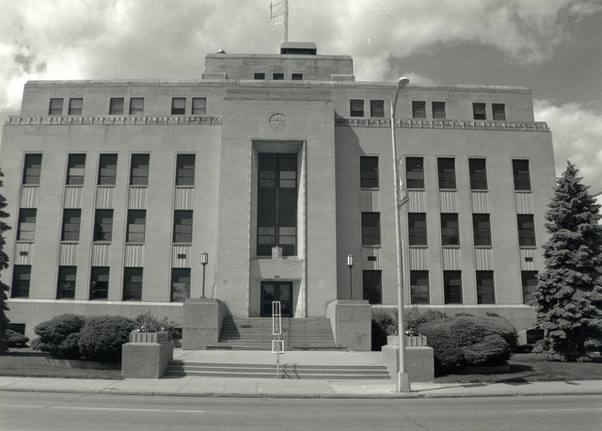
Preservation Law
The practice of historic preservation in the United States began in the mid-nineteenth century largely through private efforts such as those to preserve George Washington’s plantation, Mt. Vernon. Government was largely absent from historic preservation, with few notable exceptions, and would largely remain so until well after the turn of the century.
By the 1920s, local zoning regulations began to appear that put restrictions on what uses land could be put to within a city. The constitutionality of these zoning ordinances was upheld by the Supreme Court with the case of Village of Euclid v. Ambler Realty Co., 272 U.S. 365 (1926). In 1931 historic preservation would first become part of these relatively new land-use laws when Charleston, South Carolina, created a preservation ordinance establishing a historic district within that city. This ordinance, and the more than 2,300 like it across the nation that have since followed, controls major alterations and demolition of both individual landmarks and properties within a historic district . New construction within historic districts is also often controlled so as to ensure that new buildings are compatible in style and size with the character of the historic buildings nearby.
Typically, local historic preservation ordinances are made possible through state enabling laws. These laws transfer to local governments the right of the state to regulate private property through its police power. Historic preservation gained strength through being addressed on a local level rather than at the state or national level. These ordinances were put to the test in the case of Penn Central Transportation Co v. New York City, 438 U.S. 104 (1978). Here the Supreme Court found that preservation ordinances, if properly written, serve a valid public purpose and do not constitute a taking. As such, historic preservation ordinances do not violate the provisions of the Fifth and Fourteenth Amendments to the U.S. Constitution.
Both Wisconsin and Michigan have laws that transfer to local governments the right of the state to regulate private property through its police power. In the case of the State of Wisconsin, section 60.64 of the statutes grants towns the authority to create a landmarks commission to designate historic landmarks and establish historic districts; Michigan has Act 169, the Local Historic Districts Act, which provides for the establishment of historic districts and historic district commissions.
Interestingly, Menominee’s Historic Preservation Ordinance provides significantly greater protection for historic resources than does Marinette’s ordinance.
Page 11
Background – Marinette County Courthouse, 1926 Hall Avenue, built 1942

Slide 13
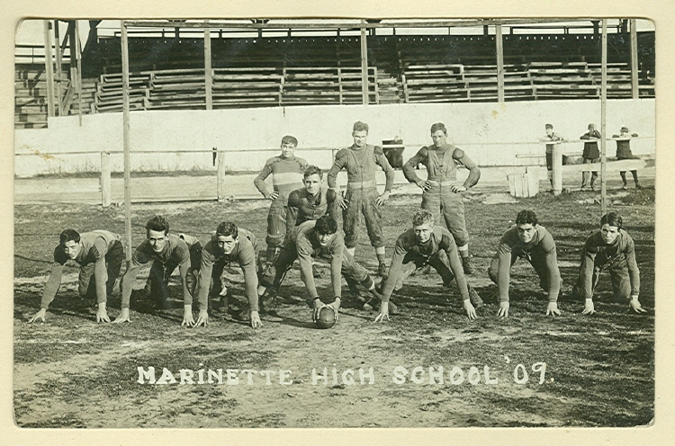
Marinette vs. Menominee
Marinette’s HP Ordinance
Menominee’s HP Ordinance
Defines a process for establishing historic districts, but does not designate any historic districts.
A historic property can not be designated a historic landmark without owner consent. Changes to historic properties not designated as historic landmarks are not subject to Historic Preservation Committee review & approval.
Should a landmark fall into serious disrepair, the city’s only recourse identified in the ordinance is to demolish the historic resource.
Penalties for failing to maintain a landmark are $200 per day, but the lack of clear definitions makes this subject to debate . There is no requirement to restore or replicate a resource that has been altered, damaged, or destroyed.
Defines a process for establishing historic districts AND creates a historic district in the downtown waterfront district consisting of four distinct sets of zoning overlay boundaries.
All properties within the historic district are automatically designated historic landmarks. All changes to these properties require Historic District Commission review & approval, regardless of owner consent.
Should a landmark fall into serious disrepair, the city has several options to save the historic resource, including making repairs and/or acquiring the property.
Penalties for failing to maintain a landmark include a one-time fine of $5,000 and violators may be ordered to restore or replicate a resource that is unlawfully constructed, added to, altered, repaired, moved, excavated, or demolished.
Background – 1909 Marinette High School Football Team,
Marinette & Menominee have the oldest interstate public high school football rivalry in the country, begun in 1894
Page 12

Slide 14
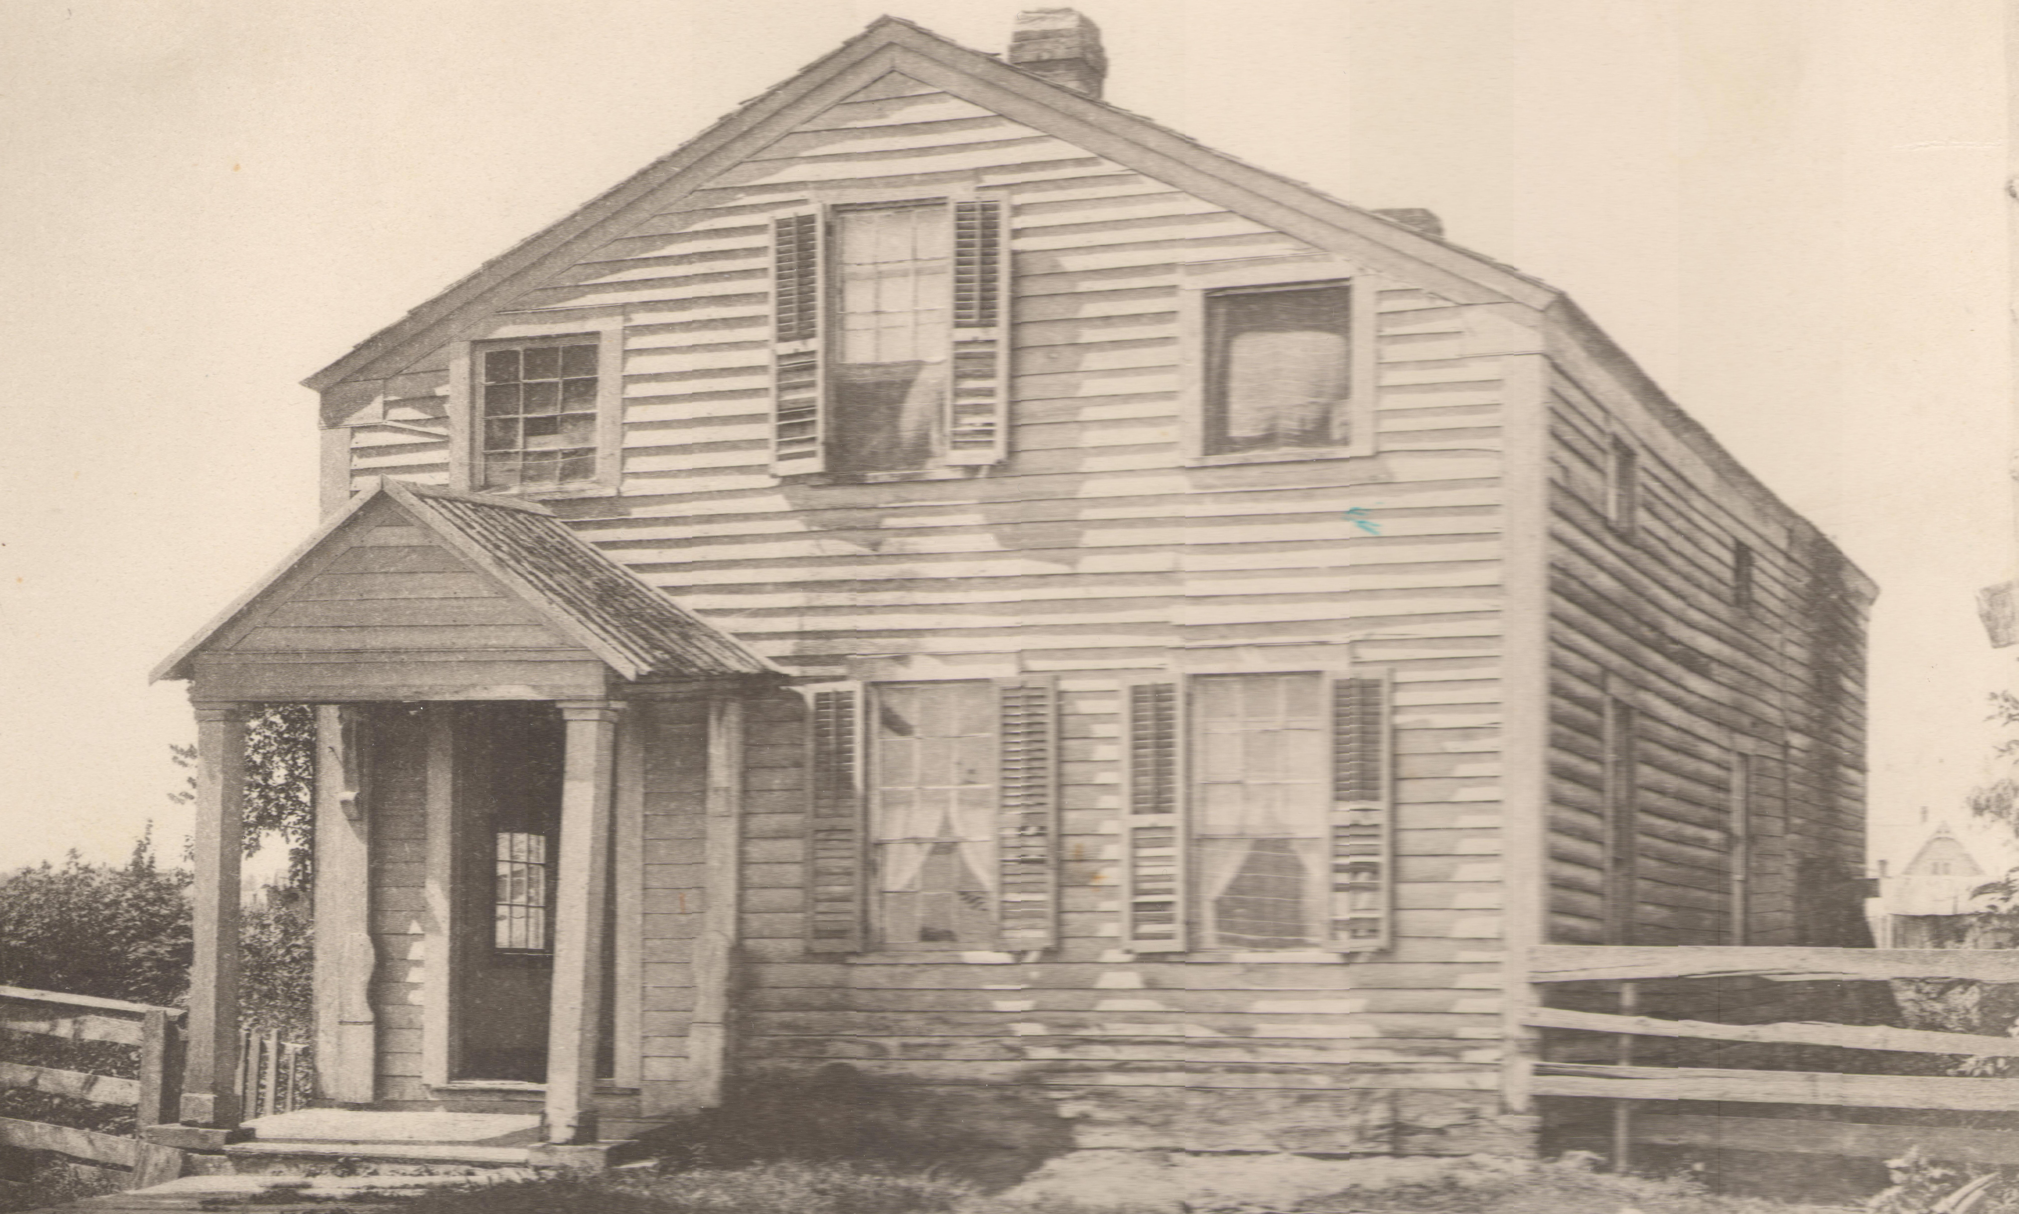
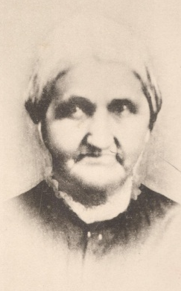
A Brief History of Historic Preservation in Marinette
As the village of Marinette moved towards incorporation as a city (which it did in 1887), some citizens began calling for the preservation of some of Marinette’s pioneer structures.
The family of Mr. Marvin James removed from their late residence the past week. This was the first dwelling house erected in Marinette with a peaked shingled roof and has been occupied by Mr. James twenty-two years. It is an old land mark and ought to be well cared for for old times’ sake. - THE NORTH STAR (newspaper), May 4, 1883
Marinette’s first City Directory was published in 1885 but, even then, house numbers were not assigned until 1887. As a result, it is not easy to establish precisely where the James residence was, but one can say with reasonable certainty that the house has since been razed. As the city began to replace pioneer buildings with more permanent structures, such editorial musings in the local papers appeared with increasing frequency. Sometimes the sentiment was one of praise for local progress, but other times, as with the clipping above, there was a sense of nostalgia for the earlier days.
Queen Marinette’s House
In addition to the trading post, Queen Marinette had a house, reported to have been built of the first lumber sawed on the Menominee River, erected about 1832 on what would later become Riverside Avenue. Beginning in the 1880s, this region between Hall Avenue and the Menominee River (west of the downtown) became the site of some of the more fashionable residences in Marinette.
Queen Marinette’s house was, even in the 1890s, undoubtedly of some historic significance to the city which bore her name. Nonetheless, the house was razed to make way for Fred Carney Jr.’s new Queen Anne cottage, built around 1895. Fred Carney Jr. was the son of a local “lumber baron”. Given that residences on this street had become quite fashionable, Queen Marinette’s house did not fit with the notions of progress at that time.
Page 13
Background – Queen Marinette and her house, built 1832

Slide 15
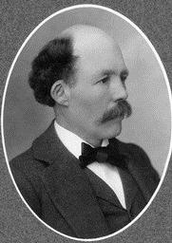
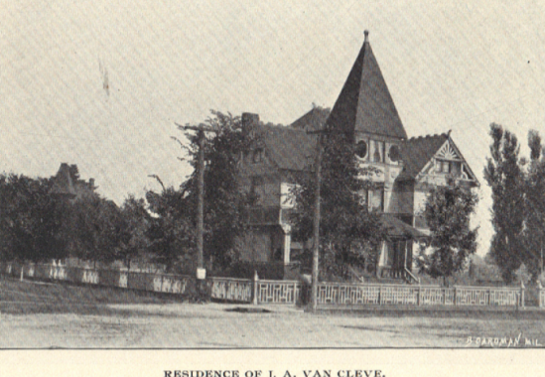
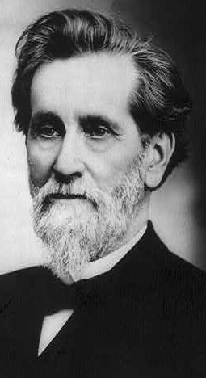
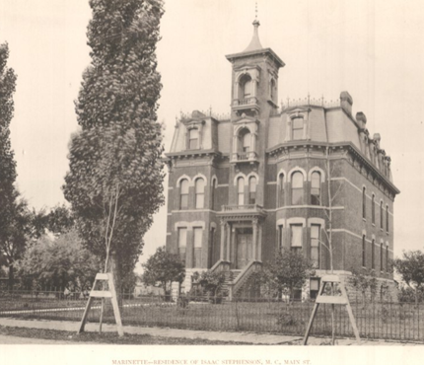
Senator Isaac Stephenson’s House
Queen Marinette’s local fame is rivaled only by Isaac Stephenson, a local lumber baron who was also a U.S. Congressman between 1883 and 1889 and a U.S. Senator between 1907 and 1915. As one of Marinette’s first millionaires, Isaac Stephenson’s name is still with us throughout the area, including the Stephenson National Bank, Stephenson Island (a public park and former site of a Stephenson lumber mill), the Stephenson Public Library (in Marinette), and the town of Stephenson, Michigan, a little over 20 miles to the north. Construction of his Main Street (Riverside Avenue) mansion began in 1882. The mansion was razed in 1920, only two years after his death. No effort appears to have been made to preserve the edifice, despite the abundance of financial resources (and descendants) to do so.
Mayor J. A. VanCleve’s House
In 1936 the Barkhausen Oil Company of Green Bay applied for a permit to build a gasoline station on the northeast corner of Hall Avenue and State Street where stood the residence of J. A. Van Cleve (Marinette’s first mayor, and its fourth). Neighbors on the prestigious State Street opposed the intrusion of business on their neighborhood and turned to the city to block this development. A special council committee was formed to study the matter and found that there were no legal barriers to prevent Barkhausen Oil from building a gas station on the property, and so the house was razed, the gas station was built and, to this day, an automotive service center occupies the lot. In the wake of the construction of the Barkhausen Oil Company gasoline station, Marinette’s first zoning ordinance was adopted. This is noteworthy as historic preservation ordinances are a form of land use regulation and would not be possible without zoning ordinances.
Page 14

Slide 16

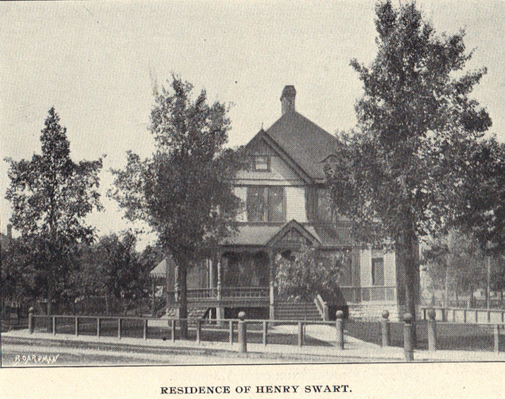
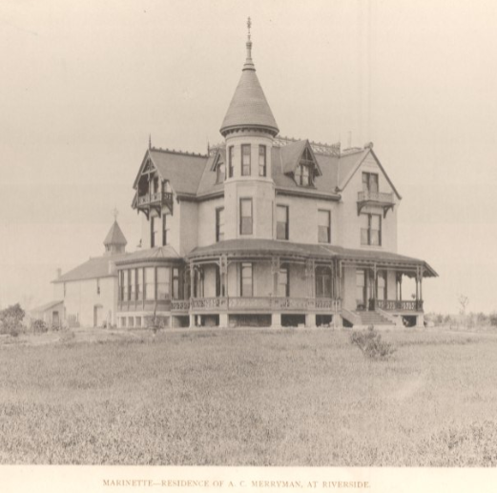
A. C. Merryman Mansion
Lumber baron A. C. Merryman’s mansion is somewhat notable in the history of preservation of Marinette, if for nothing else than the mention of the details surrounding its demolition. The Queen Anne mansion was built of stone in 1886 on a large Main Street (Riverside Avenue) estate. In addition to the carriage house, the estate, which was a full two blocks in depth, included a large pond, complete with bridge, and a horse racing track. The estate was purchased in the 1940s, razed, and, in its place, thirty-four lots for new homes were laid out. The author of Marinette’s Centennial Program spoke with the developer and a brief recounting of that discussion appears in the 1987 Marinette Centennial Program:
He [the developer] told the writer [Howard L. Emich] in 1986 that the surviving Merryman daughter sold it to him on the condition that it be razed since she didn’t wish it to be put to some demeaning use.
While the daughter’s reported motives may or may not be true, it is interesting to consider this comment in the Centennial Program as possibly being indicative of general attitudes at the time towards preservation and use of older structures in Marinette.
Duer Residence
In 1953, Dr. G. R. Duer gave his home, the former Henry Swart house, to the City of Marinette as a Memorial to his son, Lt. Richard N. Duer, who was killed in WWII . This gift was structured in such a way that the City was obligated to operate much of the house as a recreational center with an emphasis on youth activities for a period of not less than ten years. If at any time the city decided to sell the property, the house was to be sold at fair market value and all proceeds were to go to the Kansas University Association of Lawrence, Kansas, unless a building of equal value were substituted for the loss of this house.
The city operated the Duer House as a youth center until 1966. At that time, the building was sold via sealed bids to the Chamber of Commerce for $1,000, a price well below the estimated fair market value of $40,000, and subsequently razed. It would not be until 2003 that a plaque would be placed on the “Duer Gymnasium” honoring Lt. Richard Duer. The story of the Duer Residence is interesting in that it is an instance where the city was charged with the care of a historic resource that could have potentially advanced historic preservation in Marinette.
Page 15

Slide 17
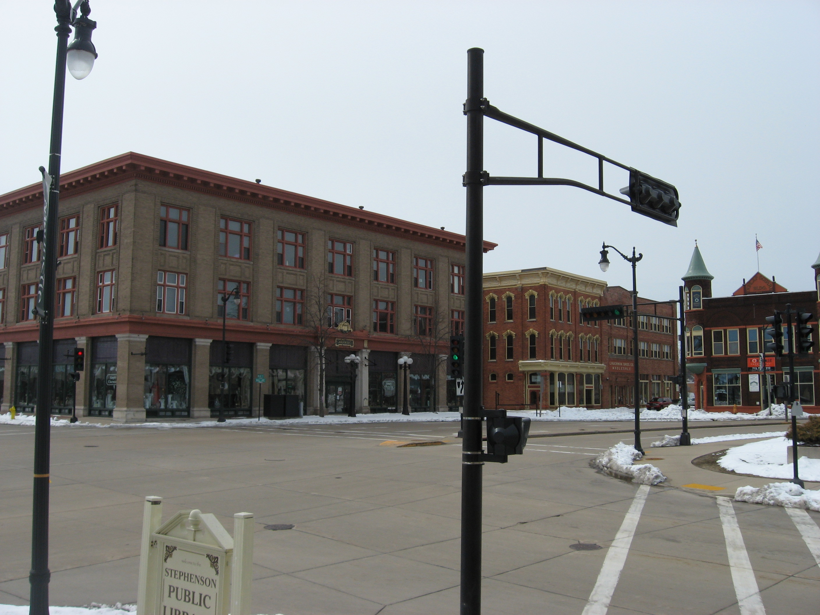
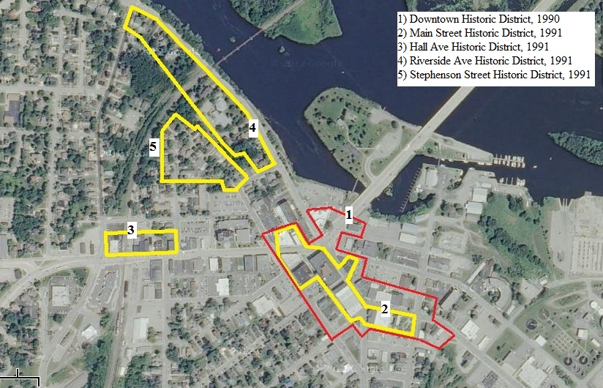
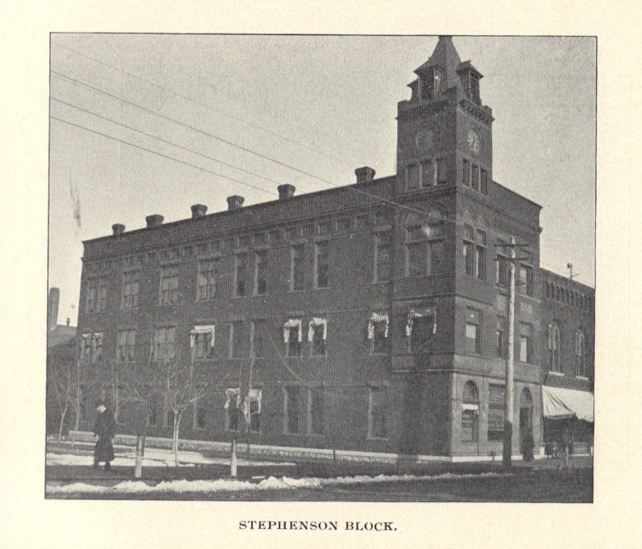
Marinette’s “Renaissance”
Significant organized historic preservation efforts in Marinette began to take shape as the city prepared for its centennial celebration in 1987. At that time, the fates of the historic downtown buildings were very uncertain. A market study for downtown redevelopment, prepared by RDR of Chicago in 1986, suggested that many Main Street and Hall Avenue properties city should be razed to make way for new retail development. By 1987, it was anticipated that a Shopko retail store would be built on or near Dunlap Square, the historic center of downtown Marinette. Also in that year, the historic Stephenson building (a commercial block with a large clock tower) on Hall Avenue, between the court house and Stephenson Street, was razed.
Aside from the loss of the Stephenson block, much of downtown Marinette was spared and Shopko eventually located its new store near the Pine Tree Mall at the southern edge of town. Between 1989 and 1992, a Main Street Program was undertaken in tandem with the Alexander Company’s rehabilitation and adaptive use of five buildings as part of the Dunlap Square project. The Marinette Downtown Revitalization Committee was optimistic of future preservation success, and in 1993, Marinette Renaissance, Inc., published a Guide to the Renovation and Rehabilitation of Downtown Marinette.
In 1990 a 24-page booklet called “Historic Marinette: Surviving Architecture of a Menominee River Boom Town” was published and included a map of a relatively large proposed downtown (mostly Main Street) historic district. In 1991 the Marinette Redevelopment Authority had an Architectural and Historical Intensive Survey Report prepared. That report included proposals for four potential historic districts within Marinette (the proposed Main Street district is about half the size of that proposed in the 1990 publication).
Background – Dunlap Square Today
Page 16

Slide 18
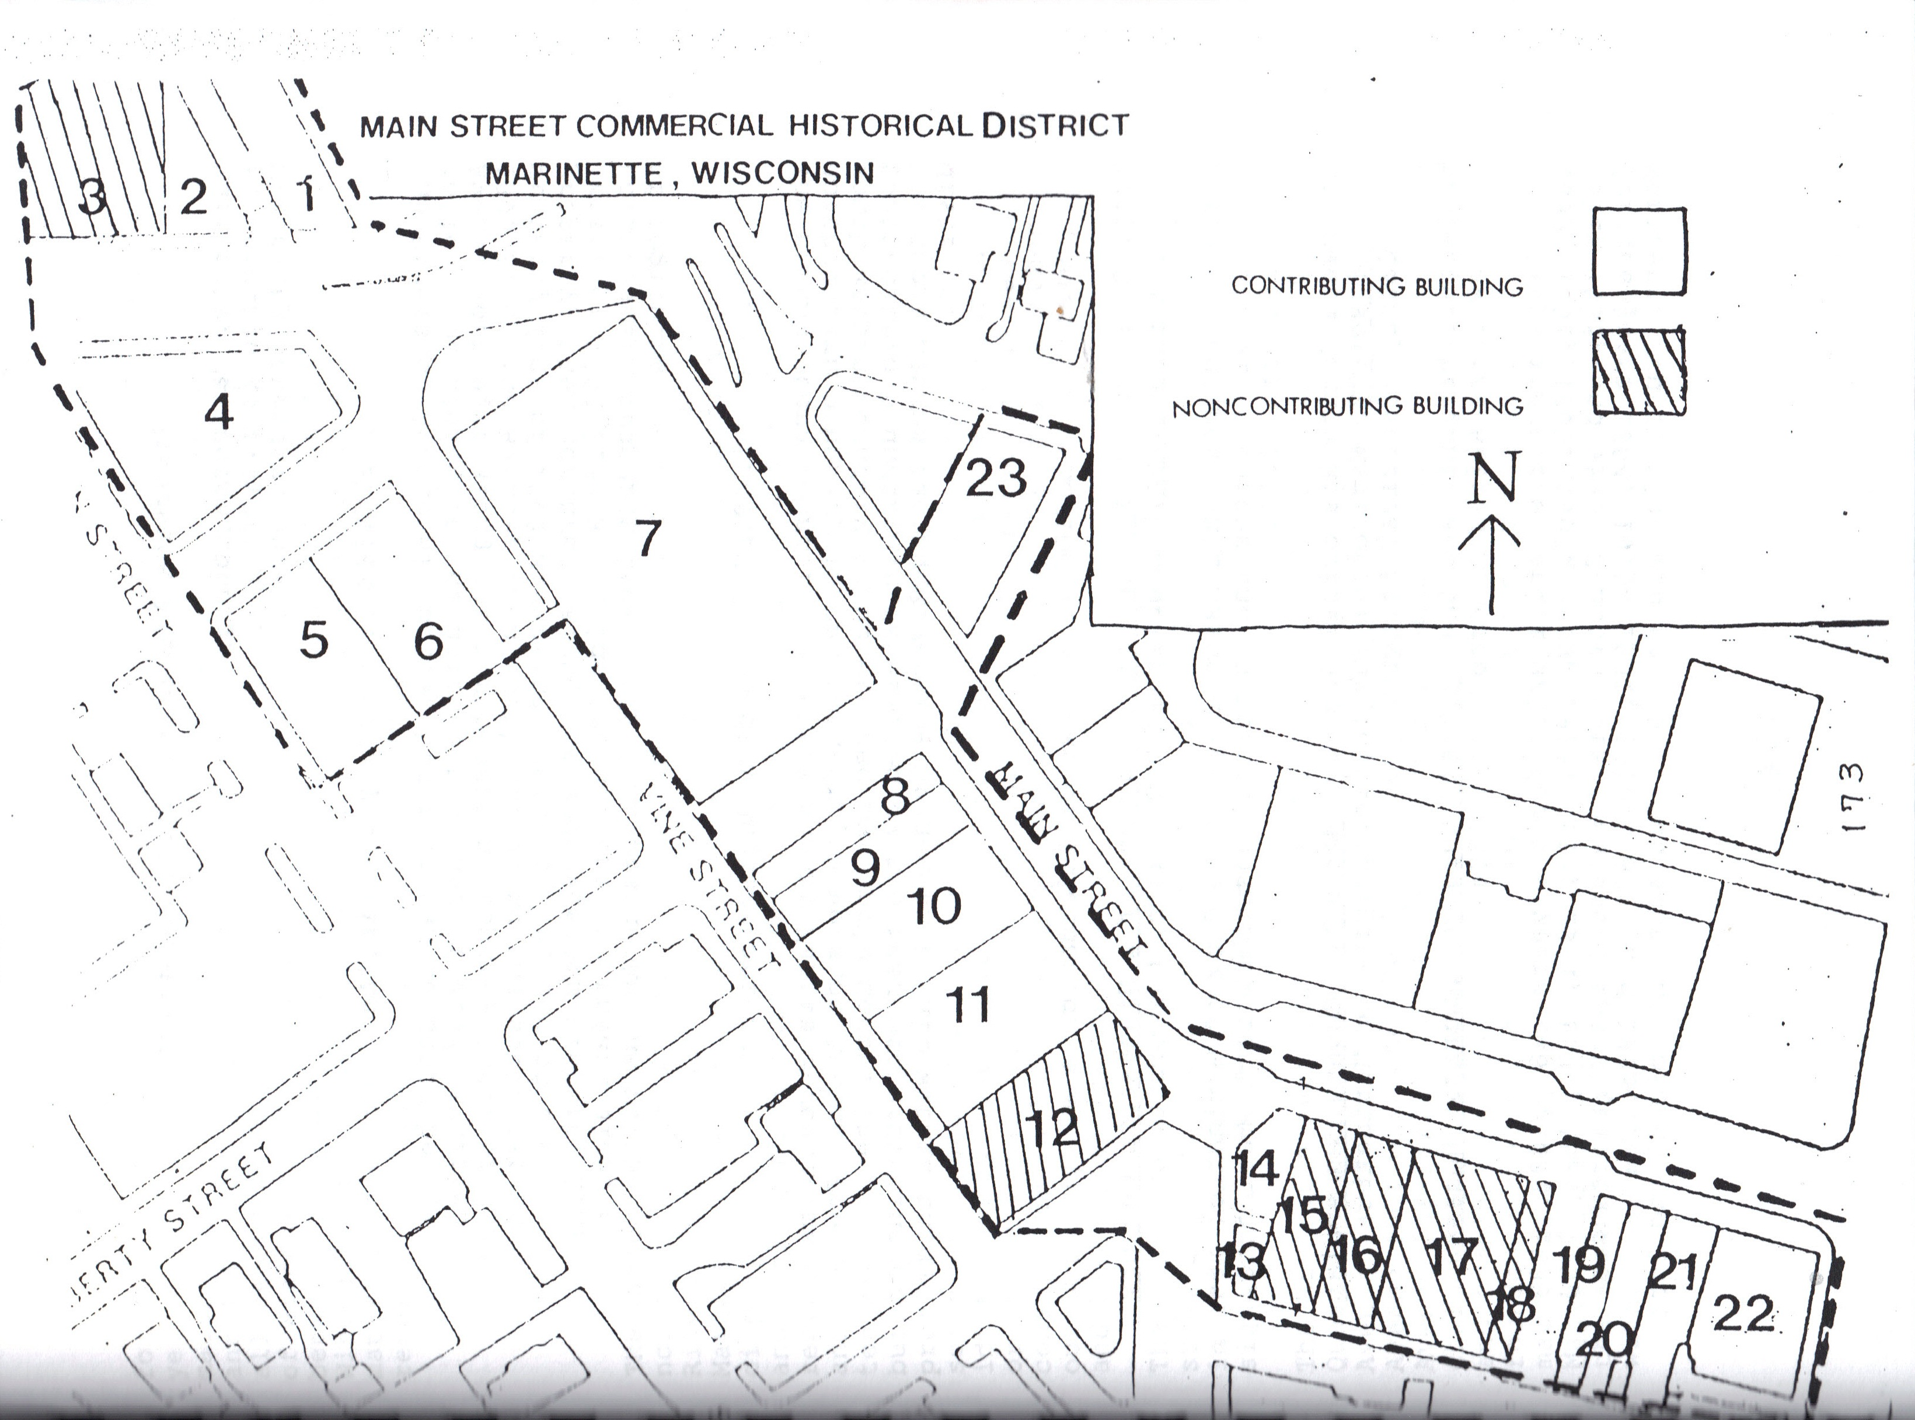
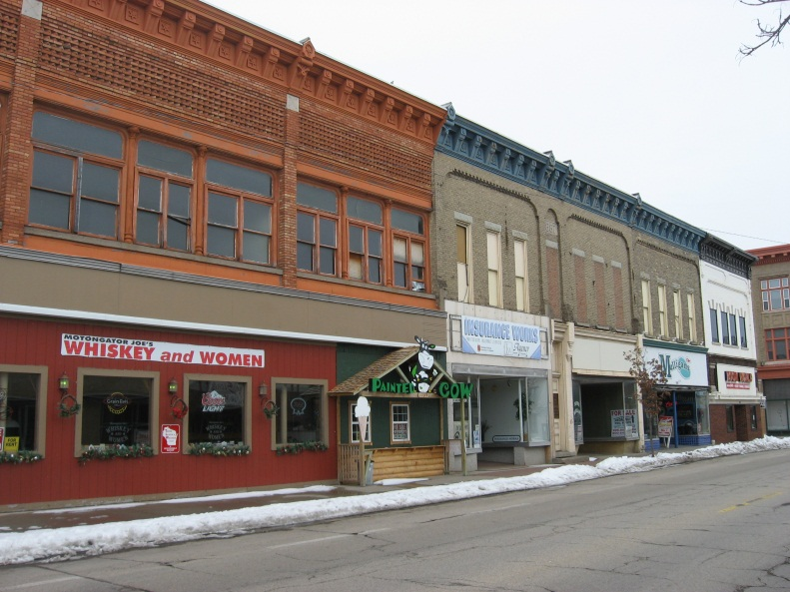
Proposed Main Street Historic District
Main Street was built across the swamp that separated Menekaunee and Marinette. Completed in 1859, this street connected the Nelson Ludington Lumber Company and the Menominee River Lumber Company.
The Main Street district is historically significant because of its commercial dominance of the Menominee River region. Anchored by the Lauerman Department Story, the Main Street business district developed into the region’s commercial hub. Main Street contained other regional retailers including the Globe Furniture Store, the Bell Clothing Store, C.A. Lind Photography, and A.O. Shoes. The district remains the most densely built commercial area in northeastern Wisconsin.
When the Main Street commercial historic district was proposed in 1991, it consisted of 23 buildings, with the potential to be expanded to include 5 additional buildings on the opposite side of the street if exterior restoration were performed. Since that time, the Ludington Hotel at 1607 Main Street and the Raiche Building at 1601-1605 Main Street have been lost. Even so, the Main Street area likely retains sufficient cohesion to warrant designation as a historic district.
1705-1723 Main Street Today
Page 17

Slide 19
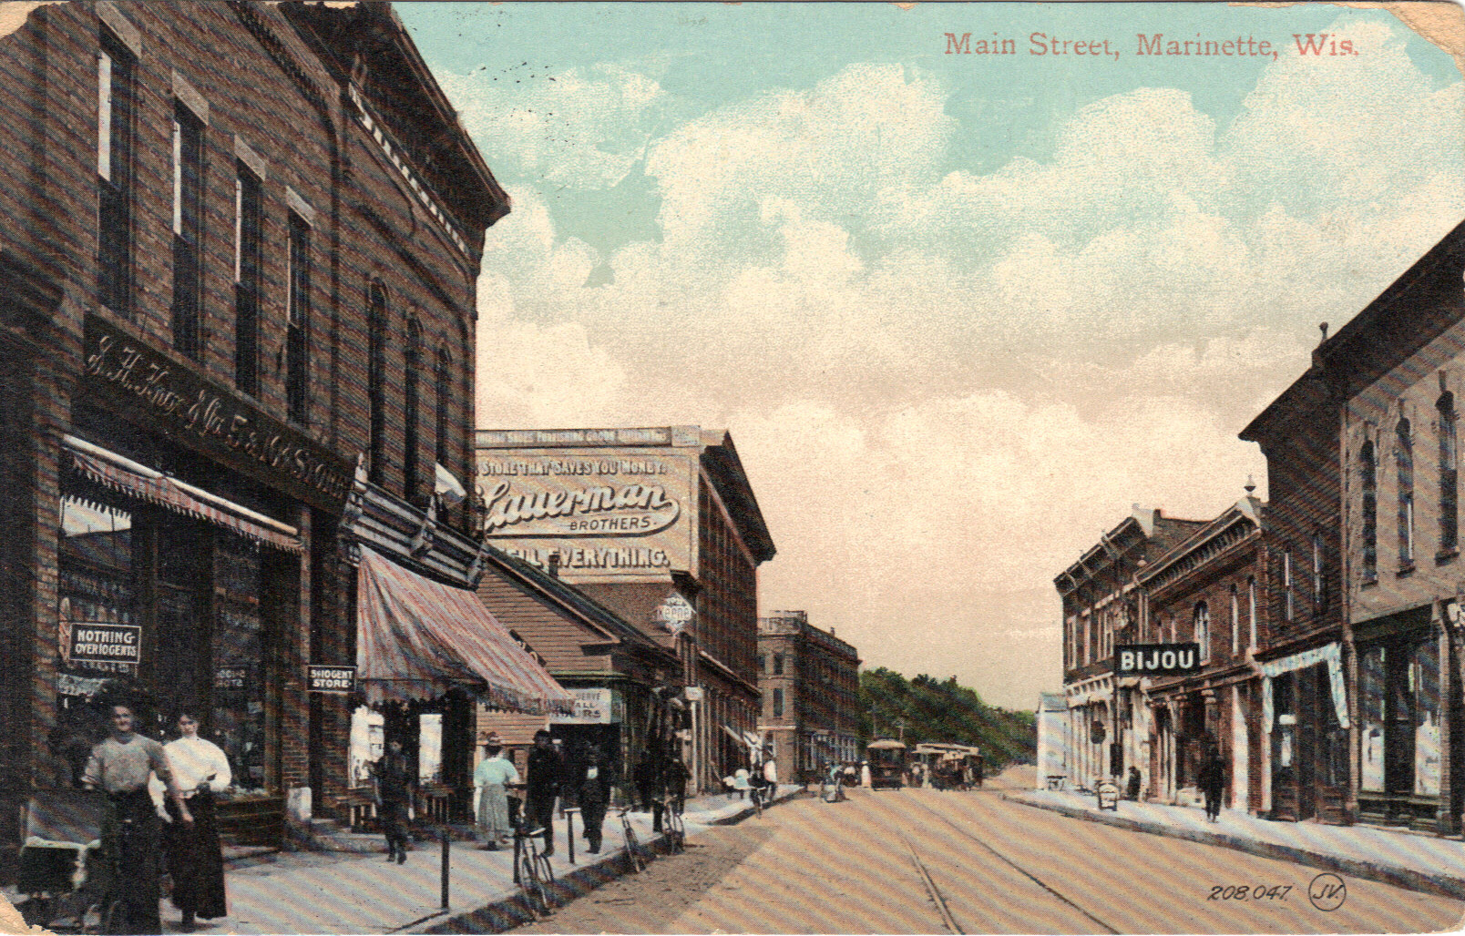
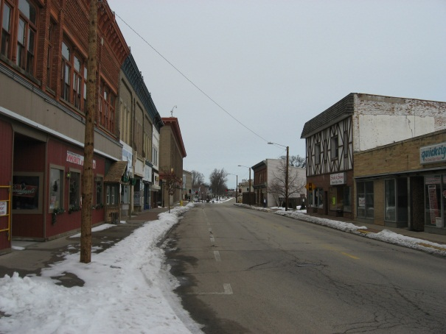
1. 1812 Hall Avenue Contributing Evenson Building (1883)
2. 1820 Hall Avenue Contributing Stephenson National Bank (1899)
3. 1820 Hall Avenue Contributing Stephenson National Bank Addition (c. 1940)
4. 1821 Hall Avenue Contributing Dunlap Square Block (c. 1901) – NRHP listed 1992
5. 1701 Dunlap Street Contributing Lauerman Warehouse Addition (c. 1915) – NRHP listed 1992
6. 1703 Dunlap Street Contributing Lauerman Warehouse (c. 1905) – NRHP listed 1992
7. 1713 Dunlap Street Contributing Lauerman Department Store (c. 1904) – NRHP listed 1992
8. 1723 Main Street Contributing Watson Brothers Building (1884)
9. 1719 Main Street Contributing North Star Publishing Building (1887)
10. 1713-17 Main Street Contributing Gustav Rienke Building (1887)
11. 1705-11 Main Street Contributing Burleigh Perkins Block (1888)
12. 1701-03 Main Street Non-Contr. First National Bank Building (1889), façade (c. 1970)
13. 710 Pierce Street Contributing (c. 1920s)
14. 1631 Main Street Contributing (c. 1880), façade (1904)
15. 1629 Main Street Non-Contr. Schuenemann Building (c. 1910), façade (c. 1970)
16. 1625 Main Street Non-Contr. Friedstein Building (c.1910), façade (c. 1970)
17. 1619-23 Main Street Non-Contr. (c. 1882), façade (c. 1970)
18. Main Street Non-Contr. (c. 1925)
19. 1611 Main Street Contributing C.A. Lind Building (1899)
20. 1609 Main Street Contributing C.A. Lind Building (1899)
21. 1607 Main Street Contributing Luddington Hotel (c. 1880), façade (c. 1890) – RAZED
22. 1601-05 Main Street Contributing Raiche Building (c. 1895), façade (c. 1915) – RAZED
23. 1722-26 Main Street Contributing Bijou Theater Building (1906) – NRHP listed 1993
Additional Potential Resources:
1610-16 Main Street Masonic Lodge (c. 1907)
1620-28 Main Street Cook Block (c. 1888)
1630-34 Main Street C.R. Johnson Block (c. 1895)
1708-10 Main Street (c. 1895)
1714-18 Main Street (c. 1884)
Main Street Today
Background – Postcard view of Main Street, c. 1910
Page 18

Slide 20
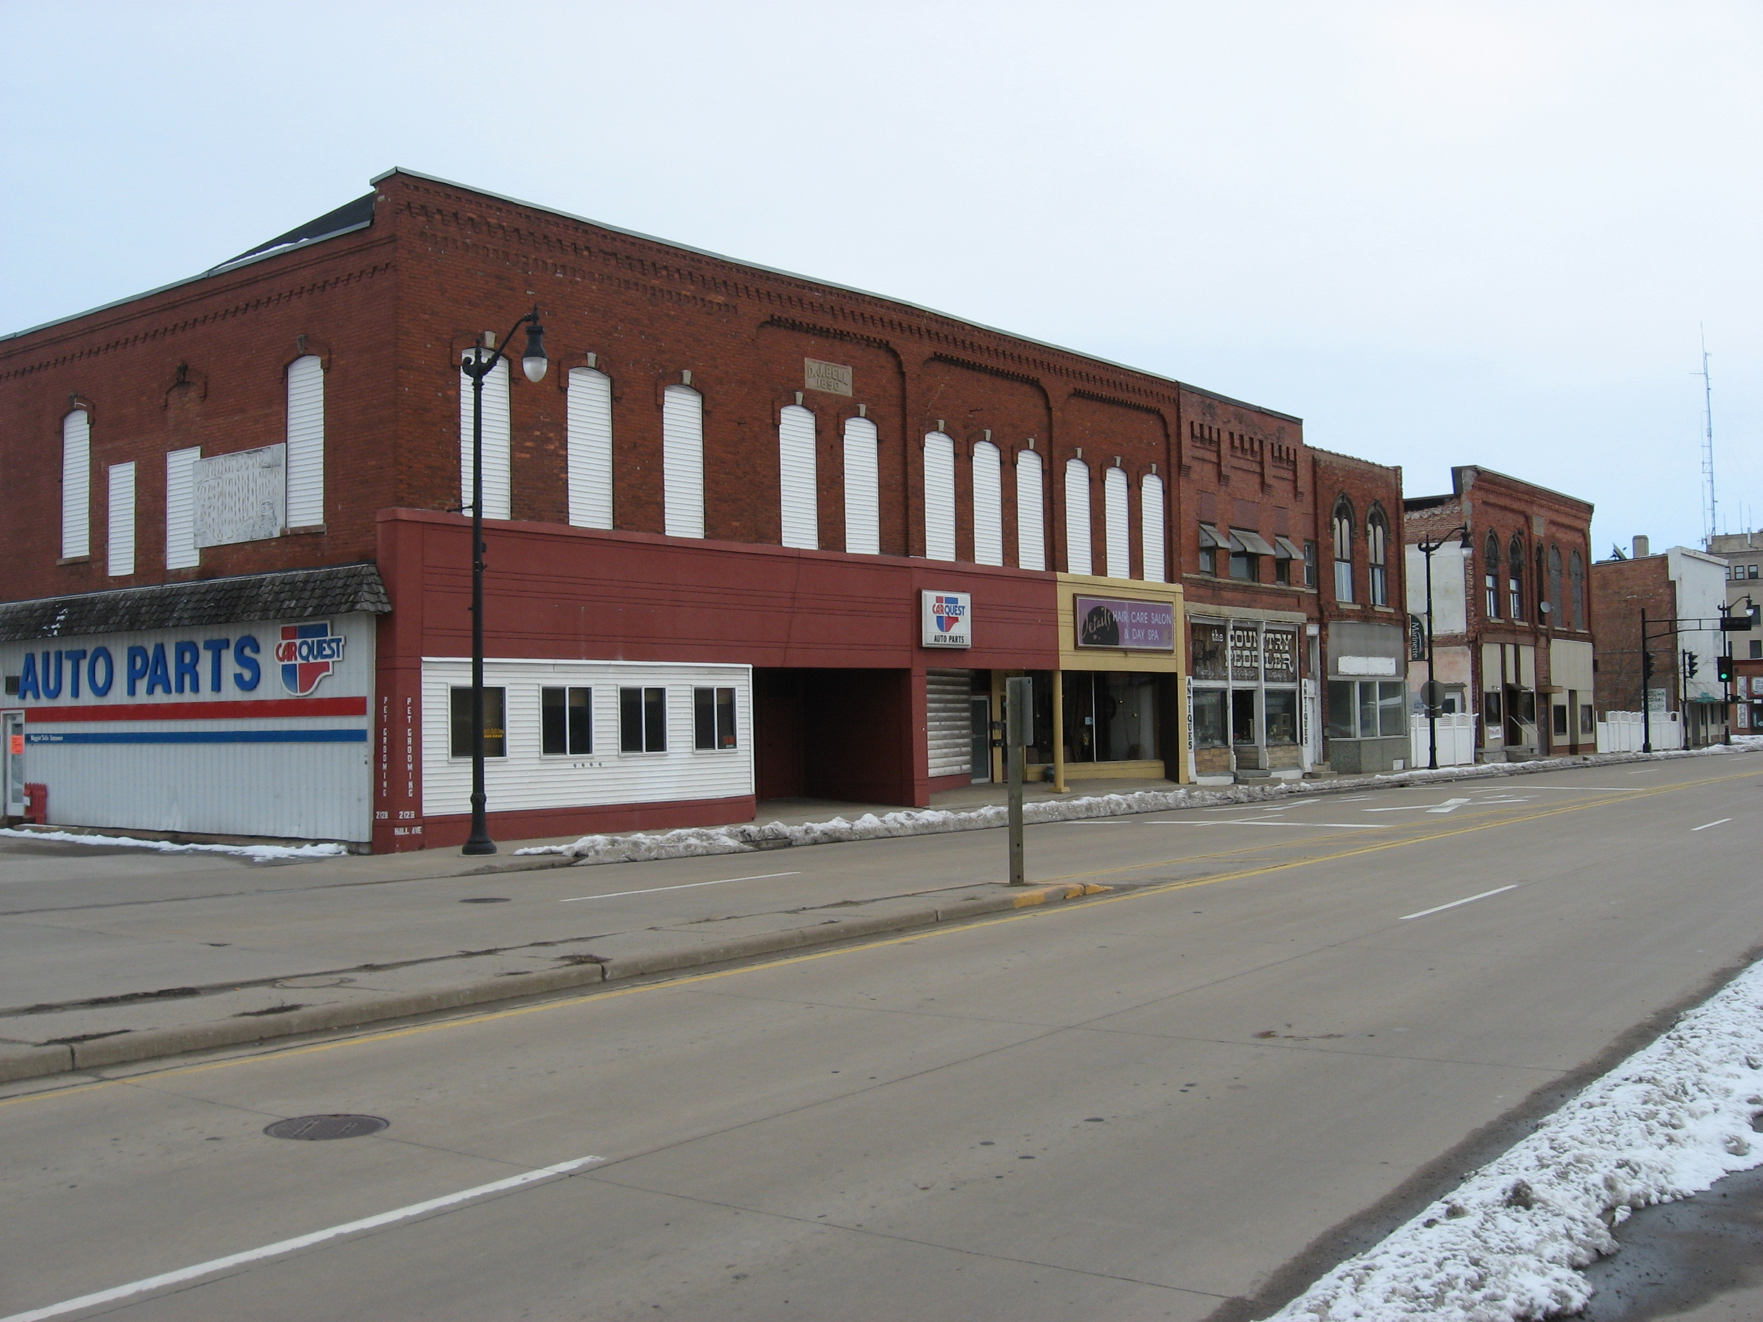
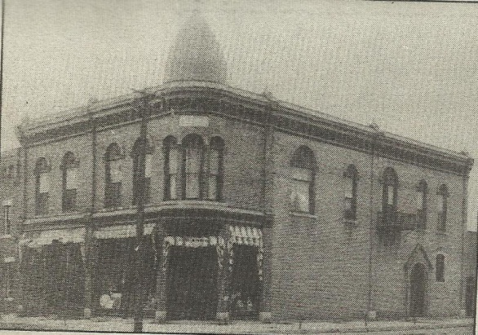
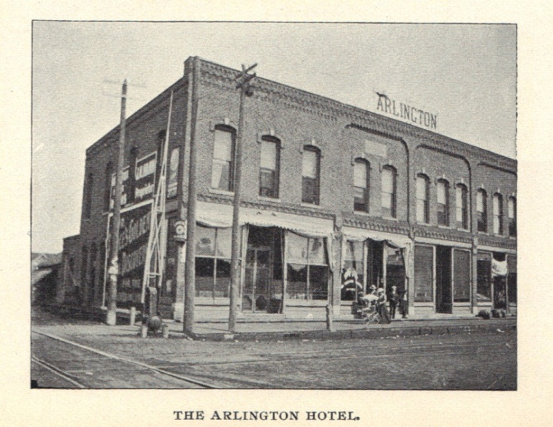
Proposed Hall Avenue Historic District
Whitbeck Block
Because of the dominance of the lumber industry and the boomtown nature of Marinette in its early years, most of the buildings were made of wood and were frequently threatened by fire in the congested downtown area. In the early 1880s, Isaac Stephenson built the first brick commercial block in Marinette on Hall Avenue, thereby encouraging commercial development westward along Hall Avenue away from downtown. In 1888 Hall Avenue was extended westward across a swamp giving farmers in the western agricultural region access to Marinette, thereby greatly increasing traffic on Hall Avenue.
The proposed Hall Avenue commercial historic district housed two former hotels; the Arlington in the J.D. Bell Block and the Windsor Hotel in F. Rock’s Block. As most work in the sawmills was seasonal, workers were transient and lived in boarding houses or hotels, making these buildings historically significant. The Hall Avenue commercial district also catered to a more local clientele than the more regionally focused Main Street area and was characterized by localized businesses such as a bakery, a meat shop, and saloons. In 1991, the Hall Avenue district was one of the best remaining examples of a local commercial district remaining in Marinette.
Page 19
J. D. Bell Block --Arlington Hotel, c. 1900
Background – Hall Avenue Today

Slide 21
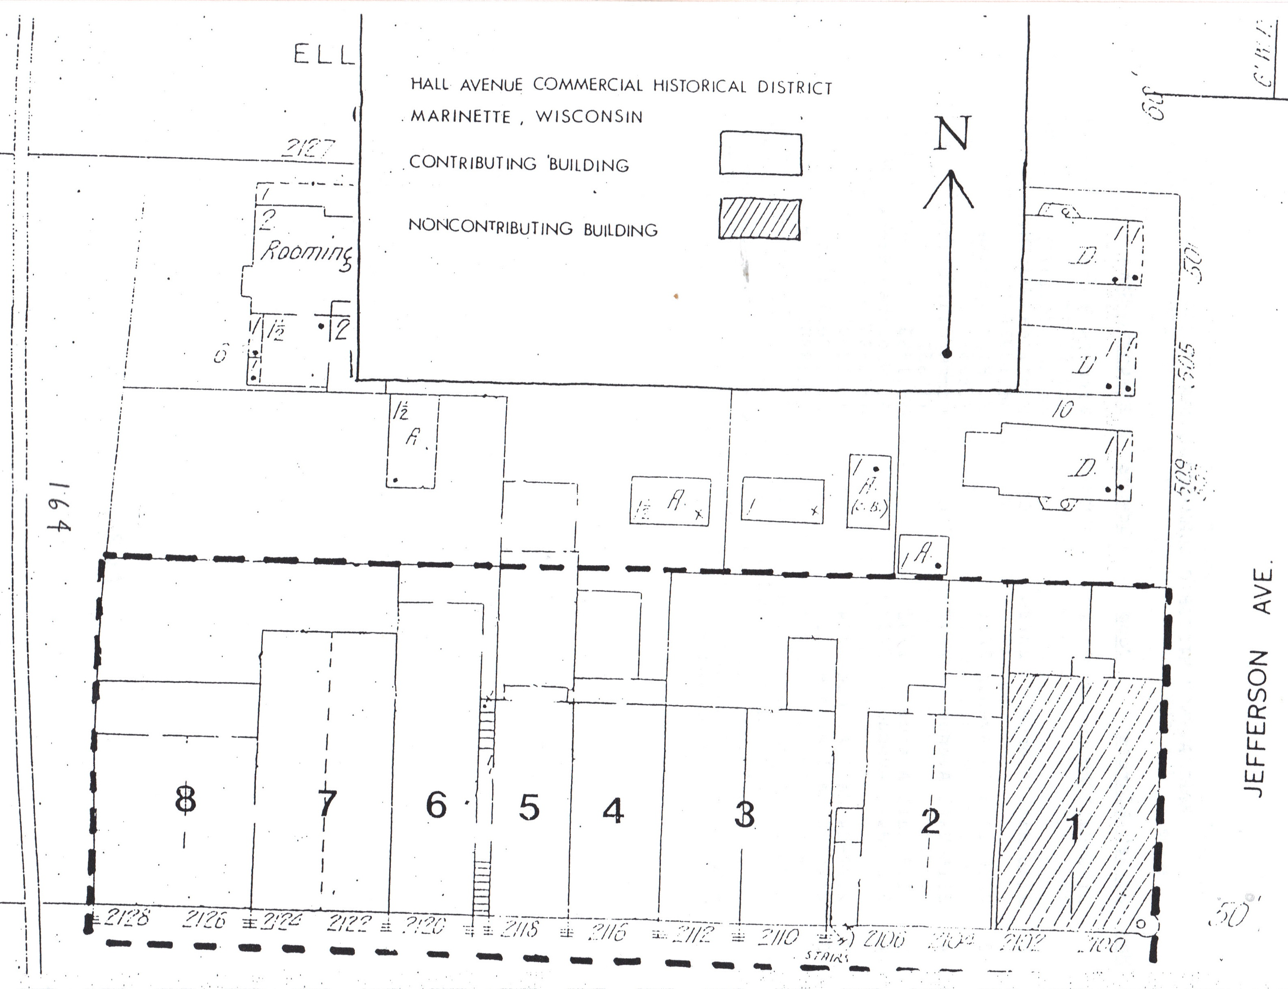
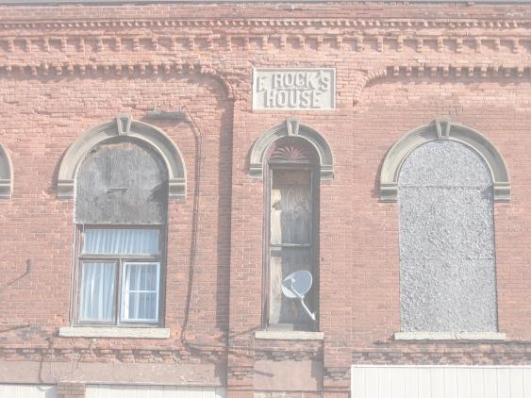
When the Hall Avenue commercial historic district was first proposed in 1991, it consisted of eight buildings. Since that time, the Martineau Building (c. 1905) at 2106 Hall Ave and another commercial building at 2116 Hall Ave have been lost. The remaining six buildings are in various states of repair and may be better suited to individual listing in historic registers rather than as a single, cohesive district.
1. 2100 Hall Avenue Non-Contr. Whitbeck Block (c.1895), façade (c. 1970)
2. 2106 Hall Avenue Contributing Martineau Building (c.1905) – RAZED
3. 2110-12 Hall Avenue Contributing F. Rock’s House (1885)
4. 2116 Hall Avenue Contributing Commercial Block (1885) - RAZED
5. 2118 Hall Avenue Contributing (c. 1880)
6. 2120 Hall Avenue Contributing J. Whelihan Block (c. 1890)
7. 2122-24 Hall Avenue Contributing (c. 1890)
8. 2126-28 Hall Avenue Contributing J.D. Bell Block (c. 1890)
Page 20

Slide 22
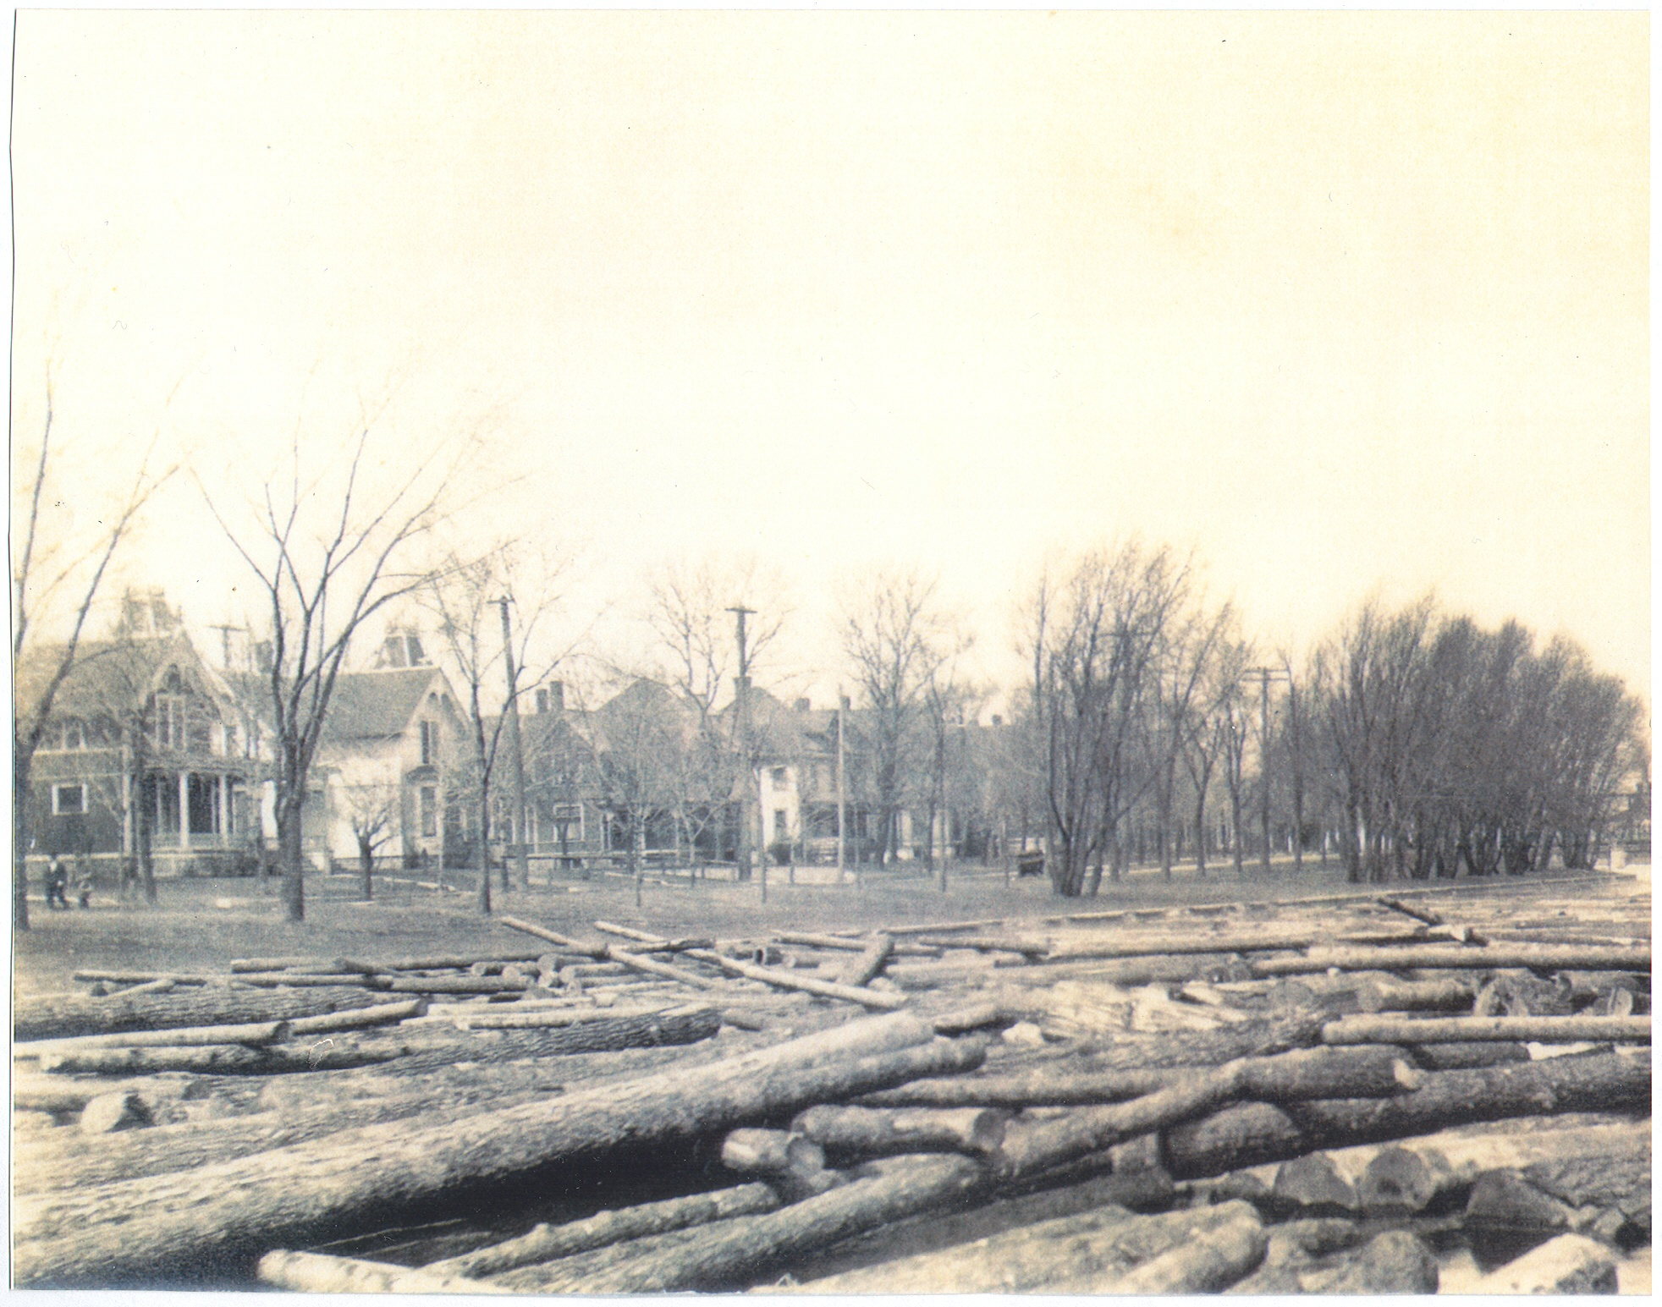
Proposed Riverside Avenue Historic District
Beginning in the 1880s, the region between Hall Avenue and the Menominee River (west of the downtown) became the site of some of the more fashionable residences in Marinette. Streets in other areas of the city were prone to inundation with high water during spring rains, but the area west of downtown was on higher ground. Until 1890, most residential streets were built paralleling Main Street east of the downtown, were located near the sawmills, and were populated primarily by sawmill laborers. The affluent members of the emerging business and professional community began to build their homes west of the downtown. Riverside Avenue was originally part of Main Street and, per the 1887 and 1895 City Directories, was renamed River Street by 1887 and Riverside Avenue by 1895. This was the most affluent street in this new area and was composed of the residences of many of the most prominent individuals in the history of Marinette.
Since first proposed in 1991, the Riverside Avenue Historic District remains relatively unchanged with no losses or additions having occurred.
Page 21
Background – Riverside Avenue, March, 1912

Slide 23
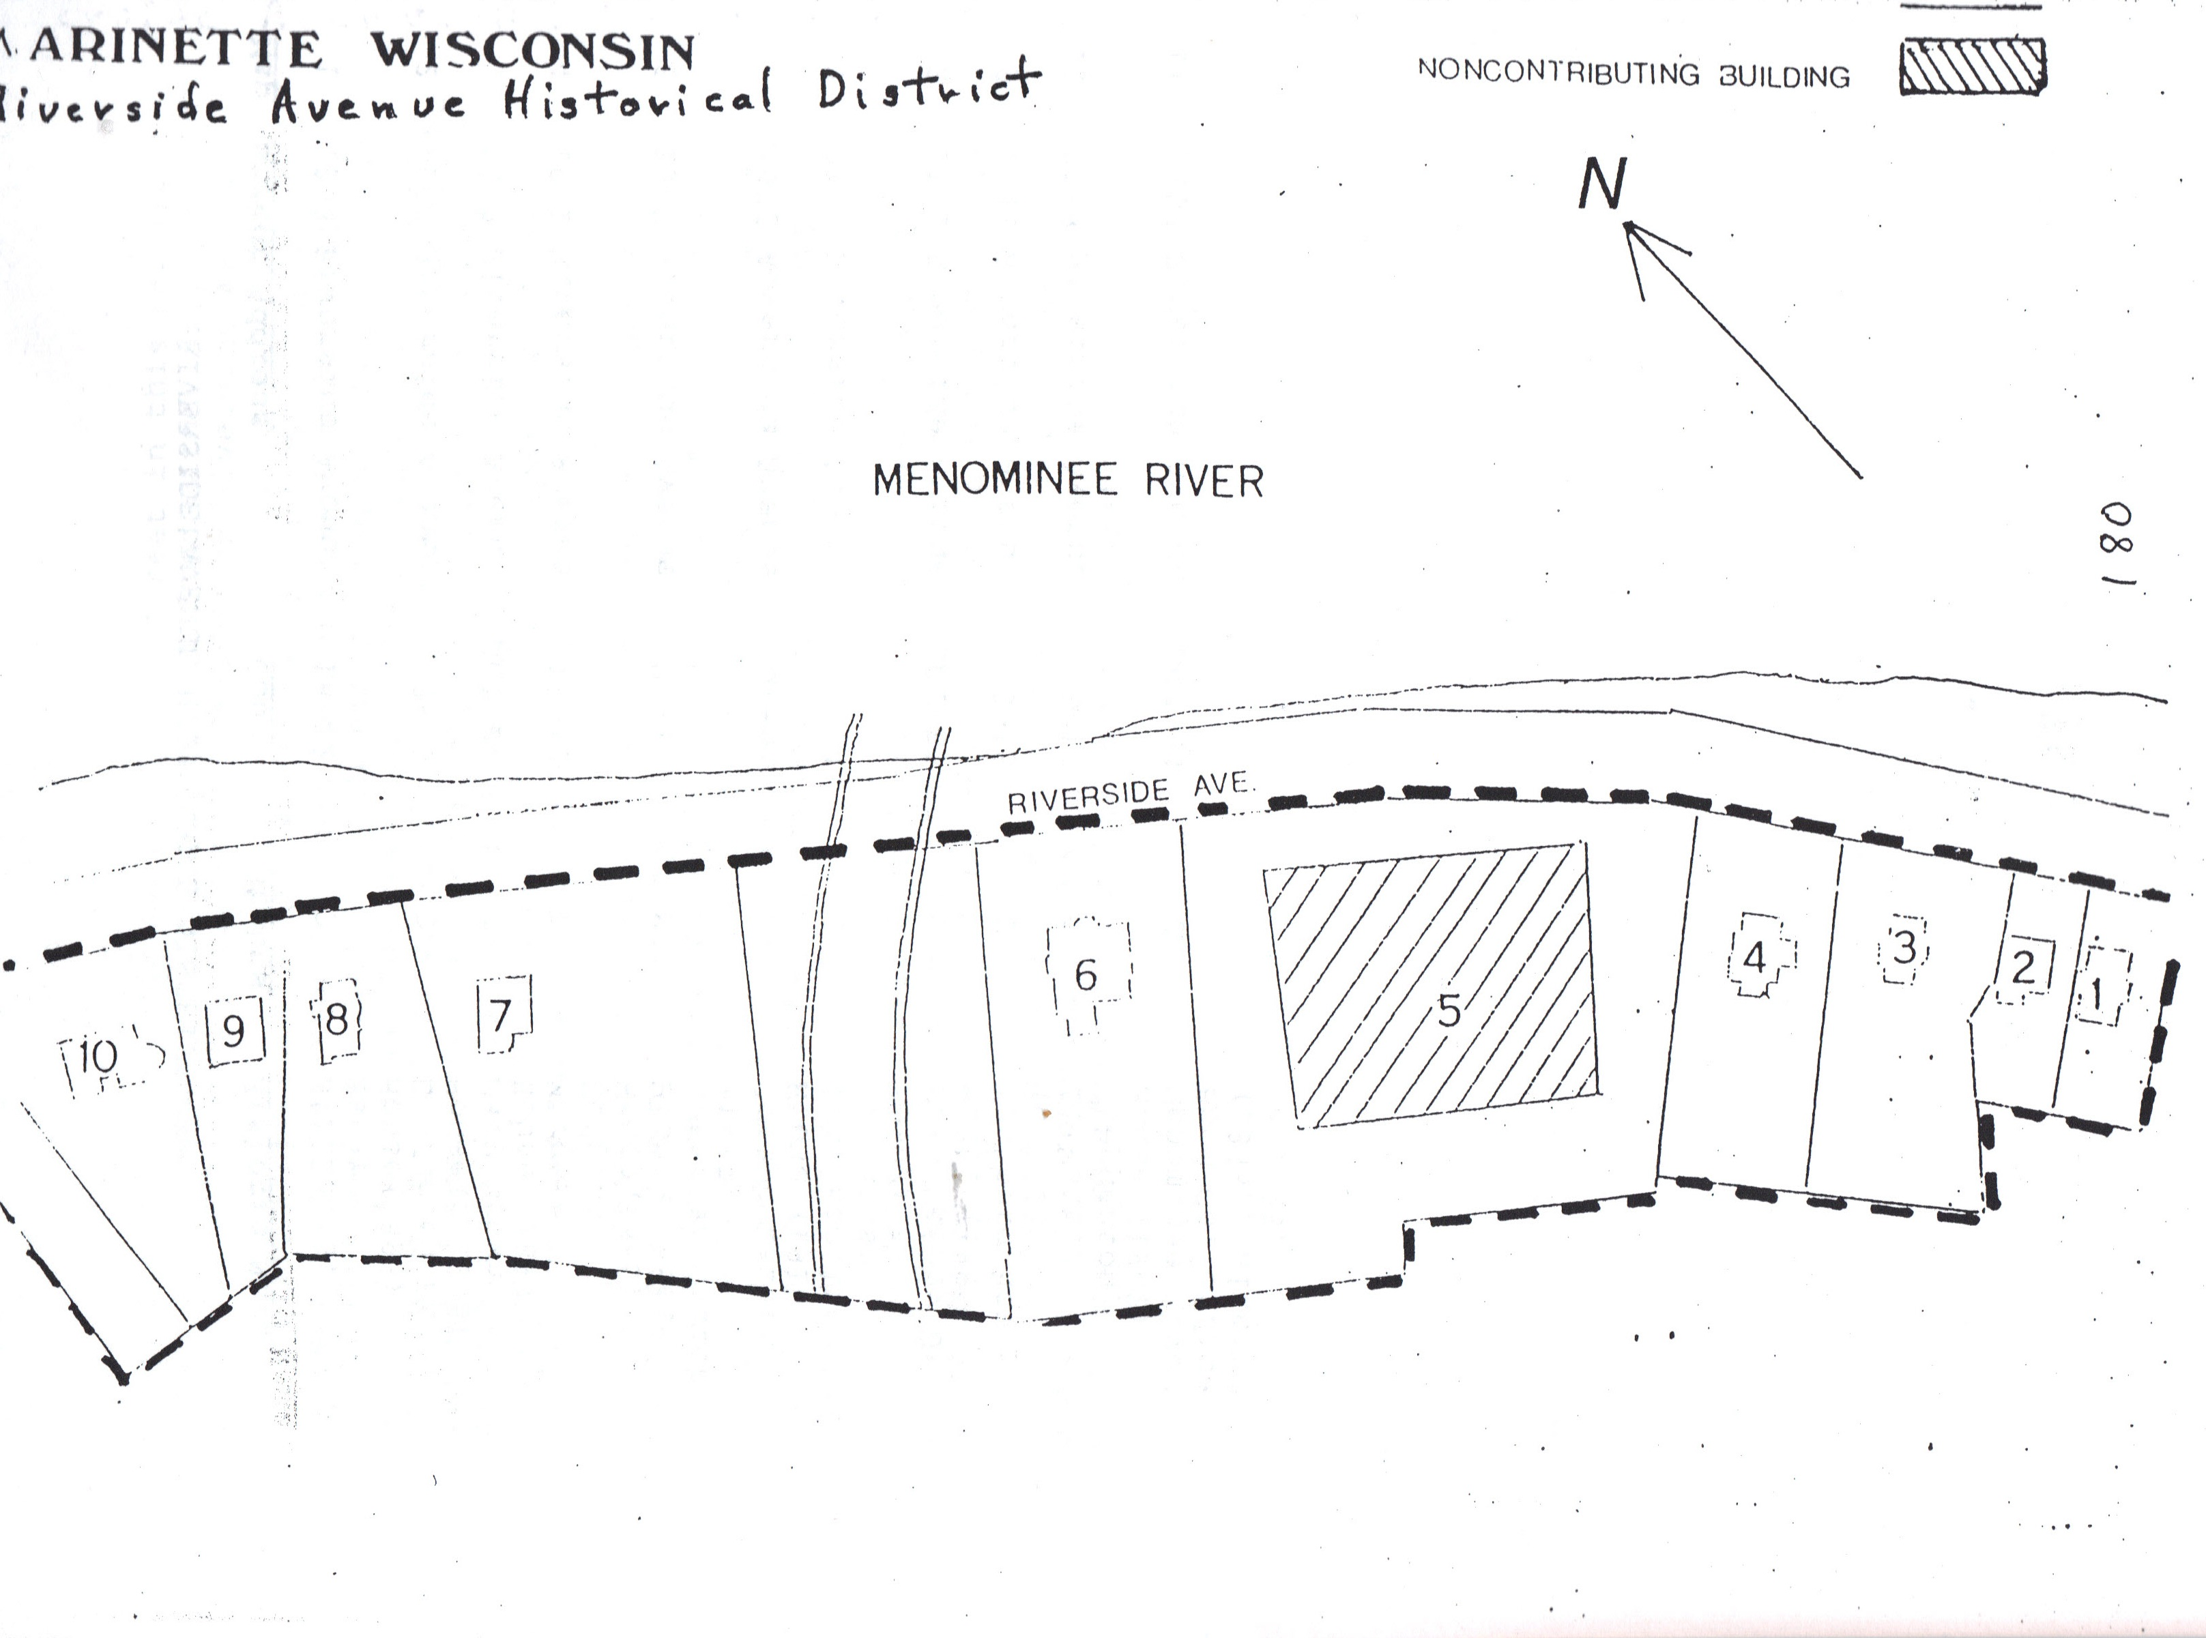
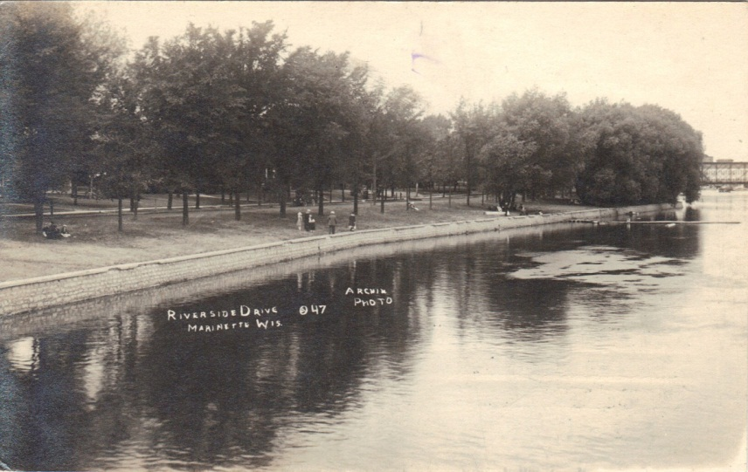
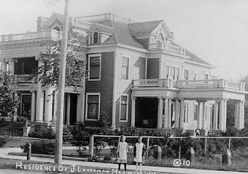
Postcard view of Riverside Avenue, c. 1900
1975 Riverside Avenue, c. 1910
1. 1903 Riverside Avenue Contributing William S. Baker House (1893)
2. 1907 Riverside Avenue Contributing E. Judson Baker House (c. 1905)
3. 1919 Riverside Avenue Contributing Mary Brown House (1885)
4. 1931 Riverside Avenue Contributing Margaret Hodgins House (1885)
5. 1947 Riverside Avenue Non-Contr. Pioneer Presybterian Church (1957)
6. 1975 Riverside Avenue Contributing Joseph Lauerman House (1910)
7. 2115 Riverside Avenue Contributing I.K. Hamilton Jr. House (1902)
8. 2125 Riverside Avenue Contributing Fred Carney Jr. House (1895)
9. 2141 Riverside Avenue Contributing Westberg House (c. 1938)
10. 2153 Riverside Avenue Contributing I. Watson Stephenson House (1902)
11. 2157 Riverside Avenue Contributing Menominee River Boom Company Office (1888), altered (c. 1928)
Page 22

Slide 24
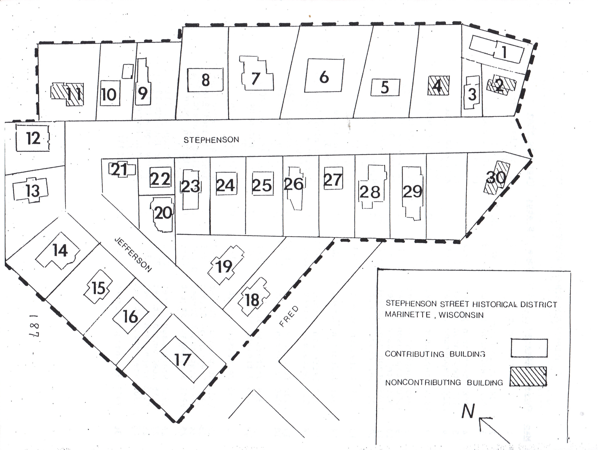
Proposed Stephenson Street Historic District
In 1893 J.A. VanCleve and Isaac Stephenson platted the region between Hall Avenue and the Menominee River. In much the same way that Marinette’s affluent built their homes on Riverside Avenue, the proposed Stephenson Street Historic District attracted the new, more affluent members of the business and professional community. In contrast to the houses on Riverside Avenue, those in the proposed Stephenson Historic District tended to be somewhat more modest, reflecting the economic stratification of the larger community. Since first proposed in 1991, two houses in this district have been lost and one has been enlarged such that it is no longer contributing. The area likely maintains sufficient integrity to warrant designation as a historic district.
Page 23

Slide 25
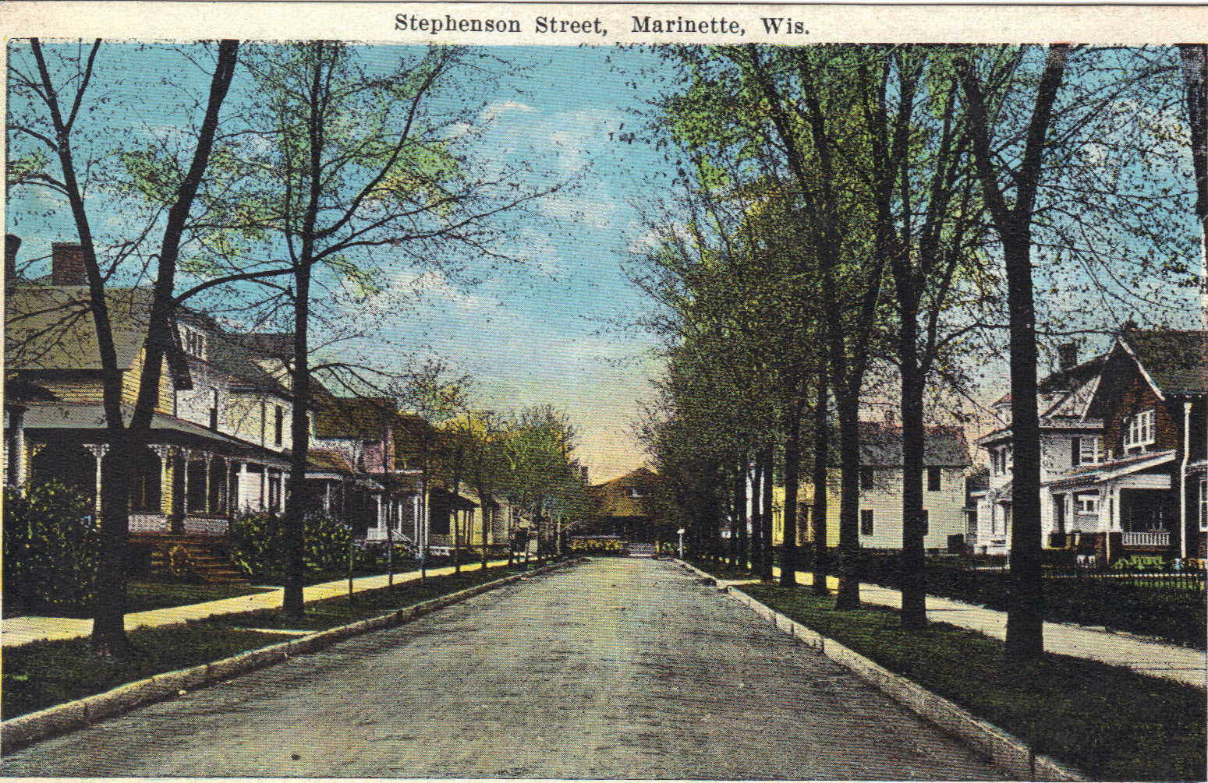

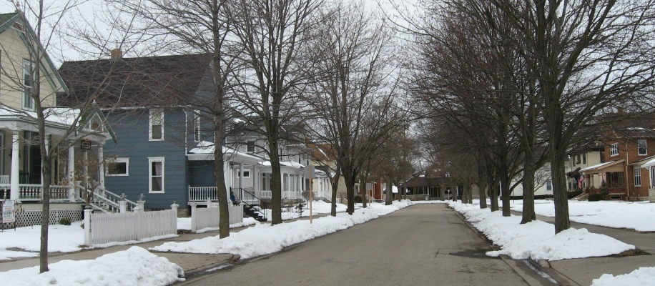
1. 30 Hattie Court Contributing William Baker House (1883)
2. 34 Hattie Court Non-Contr. (c. 1895)
3. 1902 Stephenson Street Contributing Campbell House (c. 1900)
4. 1908 Stephenson Street Non-Contr.
5. 1912 Stephenson Street Contributing (c. 1940)
6. 1920 Stephenson Street Contributing McDonald House (c. 1926)
7. 1930 Stephenson Street Contributing Lamoreaux House (c. 1920)
8. 1940 Stephenson Street Contributing Moon House (c. 1920)
9. 1950 Stephenson Street Contributing Green House (c. 1905)
10. 1954 Stephenson Street Contributing Fildes House (c. 1907)
11. 1964 Stephenson Street Non-Contr. (c. 1950s)
12. 307 Jefferson Street Contributing Schultz House (c. 1912)
13. 309 Jefferson Street Contributing C.B. Black House (c. 1905)
14. 321 Jefferson Street Contributing Quinlan House (c. 1905)
15. 337 Jefferson Street Contributing Bougie House (c. 1905)
16. 339 Jefferson Street Contributing Gerhauser House (c. 1905)
17. 2100 Fred Street Contributing Mauer House (c. 1890)
18. 340 Jefferson Street Contributing Christenson House (c. 1910)
19. 338 Jefferson Street Contributing Noel House (c. 1900)
20. 336 Jefferson Street Contributing Christenson House (c. 1900)
21. 330 Jefferson Street Contributing Callaway House (c. 1900)
22. 1949 Stephenson Street Contributing Wittig House (c. 1907)
23. 1947 Stephenson Street Contributing Dancy House (c. 1902)
24. 1943 Stephenson Street Contributing Miller House (c. 1905)
25. 1941 Stephenson Street Contributing Dickerson House (c. 1911) - ALTERED
26. 1937 Stephenson Street Contributing May House (c. 1911) - RAZED
27. 1915 Stephenson Street Contributing Baker House (c. 1900)
28. 1913 Stephenson Street Contributing LeRoy House (c. 1900)
29. 1909 Stephenson Street Contributing Hitchon House (c. 1900) – RAZED
30. 1901 Stephenson Street Non-Contr. (c. 1884)
Stephenson Street scene, 1941
Stephenson Street Today
Background – Postcard view of Stephenson Street, c. 1910
Page 24

Slide 26
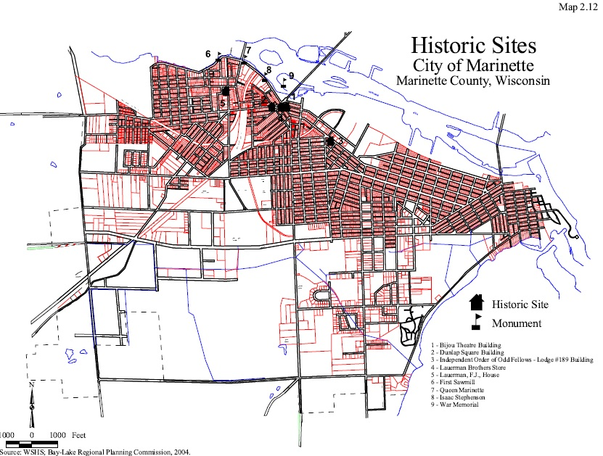
Marinette’s Designated
Historic Landmarks
Although the City of Marinette has yet to designate any local historic districts, a few individual properties have been listed in the National Register of Historic Places (NRHP). Many people believe that historic landmarks are afforded the highest protection through nomination to and listing in the National Register of Historic Places. Per the National Park Service, the government entity that maintains the National Register, “National Register listing places no obligations on private property owners. There are no restrictions on the use, treatment, transfer, or disposition of private property”. A property that is listed in the National Register of Historic Places can, for example, be torn down by the owner without any penalty. The same is true for properties listed in the Wisconsin State Register of Historic Places.
Federal and state preservation laws offer little protection for historic resources. It is at the local level that historic landmarks can be provided the greatest protection—through a strong local historic preservation ordinance. The strength of the protection for historic sites varies based, in part, on the powers granted to the historic preservation commission, the level of interim protection afforded to properties that are potentially eligible for nomination as historic landmarks, and explicitly stated significant penalties, including substantial fines that accrue on a daily basis, a requirement to restore landmarks that are willfully damaged or destroyed, denial of permits to rebuild on sites where a landmark has been willfully destroyed, or even jail time.
The City of Marinette currently has no properties that have been designated as local historic landmarks. This is not to say that there is a lack of local historic resources worthy of nomination—for example, the properties listed in the National Register of Historic Places warrant the real protection that only a local preservation ordinance can provide. On the contrary, this highlights the need for a reinvigoration of local historic preservation efforts so as to safeguard those yet-to-be-designated local resources.
Marinette’s NRHP-listed properties are the Bijou Theater Building (1722-1726 Main St), the Dunlap Square Building (1821 Hall Ave), the Independent Order of Odd Fellows – Lodge # 189 Building (1335 Main St), the Lauerman Brothers Department Store (1701-1721 Dunlap St), the F.J. Lauerman House (383 State St), the Milwaukee Road Depot (650 Hattie St), and the Chautaqua Grounds archaeological site.
Page 25
Background – Map of Marinette’s Historic Sites as found in the City of Marinette 2020 Comprehensive Plan

Slide 27
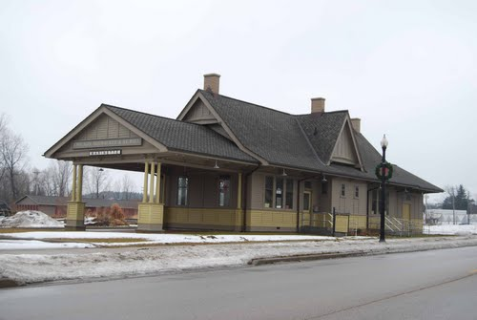
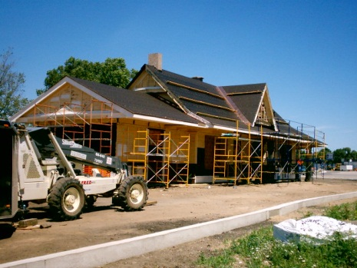
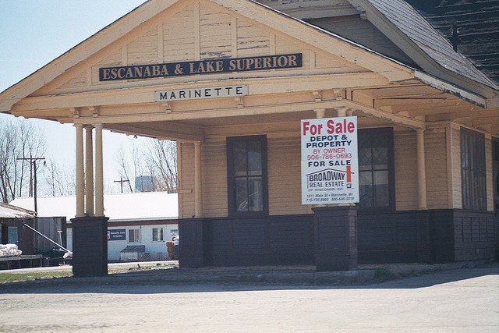
Recent Preservation Issues
In addition to identifying four proposed historic districts in Marinette, the Marinette Redevelopment Authority’s Architectural and Historical Intensive Survey Report of 1991 included five recommendations for future action
Preparation of an official Preservation Plan and its adoption as part of the City Master Plan.
Creation of a Local Historic Preservation Ordinance and Commission.
Certification by the State of Wisconsin as a Certified Local Government.
Preparation of a Multiple Resource Nomination to the National Register Nomination of the proposed commercial and residential districts.
Implementation of a systemic plan of public education concerning preservation of historic resources.
The 1993 Guide to the Renovation and Rehabilitation of Downtown Marinette may have partially fulfilled the first objective and the City of Marinette 2020 Comprehensive Plan does make brief mention of historic preservation in Marinette. The second objective was realized through the enactment of the historic preservation ordinance in 1995, but it has subsequently been weakened significantly. It is not clear if the other three objectives were ever begun, but they were certainly never achieved, nor did Marinette establish a single historic district.
Unfortunately, just as Marinette’s preservation ordinance was enacted, interest in such efforts largely disappeared. In the years that followed, the fates of the Milwaukee Road Train Depot and the Colonial Building would become polarizing political issues and lead to changes in both the mayor’s office and in the preservation ordinance. The Depot, which the railroad closed in 1989, would become the sticking point of a proposed Walgreens development in 2003 before ultimately being relocated and rehabilitated, through grants and private funds, in 2005. In the case of the Colonial Building (the city’s first YMCA), the Historic Preservation Commission designated the building a local historical structure in 1999, thereby putting an end to the owner’s plans to raze the building. Ownership subsequently changed hands, but repairs were never made to stabilize the granite façade of the city’s last remaining Richardsonian Romanesque building. The fate of the building would continue to unravel until, under the weakened historic preservation ordinance, the city condemned it in 2007 and razed it in 2008.
Background – Milwaukee Road Train Depot, built 1903, restored & NRHP listed 2005
Page 26

Slide 28
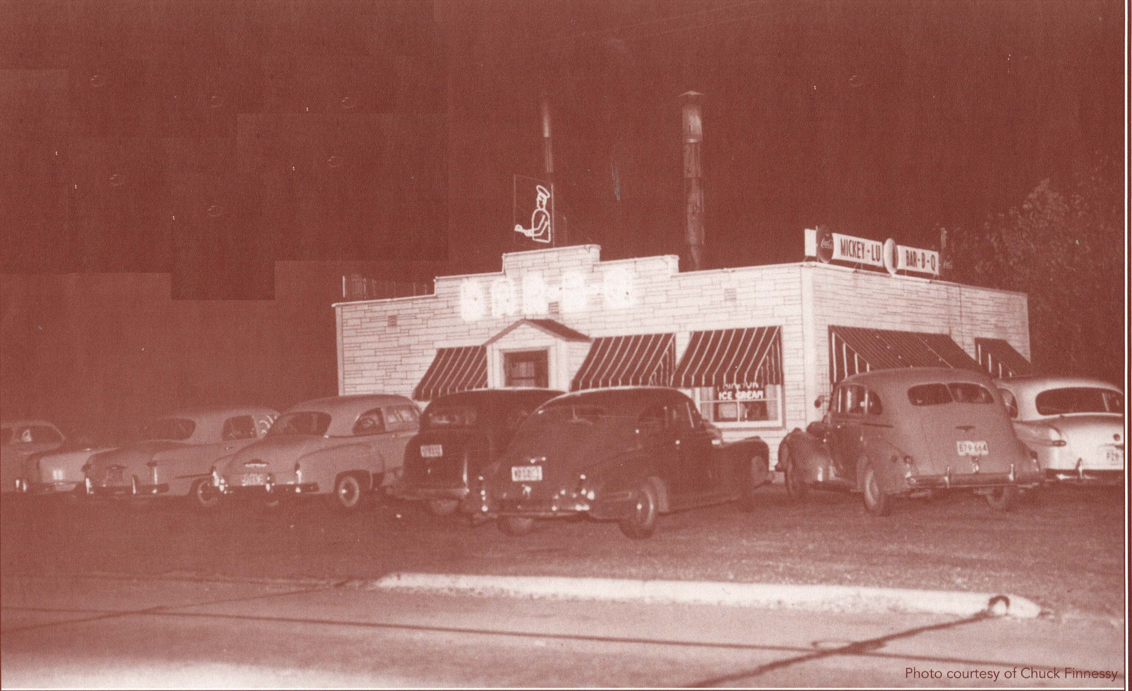
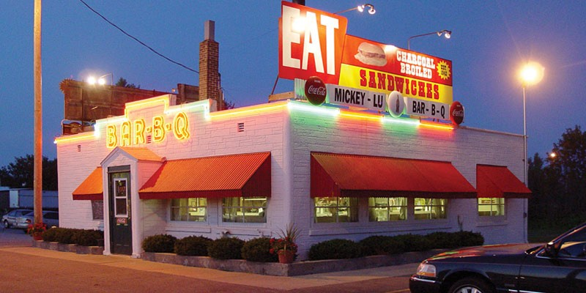

Incentives for Historic Preservation
Historic Preservation offers a number of potential financial benefits to property owners. In order to be eligible for many of the federal and state benefits, a property must either be listed in or eligible for listing in the National Register of Historic Places and, by extension, the Wisconsin State Register of Historic Places.
National Register Listing
Created by the National Historic Preservation Act of 1966, our nation’s National Register of Historic Places (NRHP) is part of a national program to coordinate and support public and private efforts to identify, evaluate, and protect America’s historic and archaeological resources. In order to be eligible for listing in the NRHP, a property must meet the National Register Criteria for Evaluation which include age, significance, and integrity. Listing in the NRHP provides formal recognition of a property’s historical, architectural, or archaeological significance based on national standards. Listing also provides an opportunity to claim federal and state tax credits for rehabilitation expenses.
20% Federal Tax Credit
A 20% income tax credit is available for the rehabilitation of historic, income-producing buildings that are determined by the Secretary of the Interior, through the National Park Service, to be “certified historic structures.” The State Historic Preservation Offices and the National Park Service review the rehabilitation work to ensure that it complies with the Secretary’s Standards for Rehabilitation. The Internal Revenue Service defines qualified rehabilitation expenses on which the credit may be taken. Owner-occupied residential properties do not qualify for the federal rehabilitation tax credit.
10% Federal Tax Credit
The 10% tax credit is available for the rehabilitation of non-historic buildings placed in service before 1936. The building must be rehabilitated for non-residential use. In order to qualify for the tax credit, the rehabilitation must meet three criteria: at least 50% of the existing external walls must remain in place as external walls, at least 75% of the existing external walls must remain in place as either external or internal walls, and at least 75% of the internal structural framework must remain in place. There is no formal review process for rehabilitations of non-historic buildings.
Page 27
Background – Mickey-Lu Bar-B-Q, built 1942, then & now, is not NRHP listed (yet)

Slide 29


25% Wisconsin Tax Credit
The Wisconsin Historical Society's Division of Historic Preservation administers a program of 25 percent state income tax credits for repair and rehabilitation of historic homes in Wisconsin. This credit is only applicable for your personal residence that is listed in the national or state register of historic places, is a contributing house within a historic district, or has been determined to be eligible for individual listing in the national or state register. The homeowner must spend at least $10,000 on eligible work within a two year period.
5% Wisconsin Tax Credit
Wisconsin Supplemental Historic Preservation Credit returns an additional 5 percent of the cost of rehabilitation to owners as a discount on their Wisconsin state income taxes. Owners that qualify for the Federal Historic Preservation Credit automatically qualify for the Wisconsin supplement if they get NPS approval before they begin any work.
Tax Benefits for Historic Preservation Easements
A historic preservation easement is a voluntary legal agreement, typically in the form of a deed, that permanently protects an historic property. Through the easement, a property owner places restrictions on the development of or changes to the historic property, then transfers these restrictions to a preservation or conservation organization. A historic property owner who donates an easement may be eligible for tax benefits, such as a Federal income tax deduction. Easement rules are complex, so property owners interested in the potential tax benefits of an easement donation should consult with their accountant or tax attorney.
City of Marinette Façade Improvement Program
The City of Marinette will provide financial assistance, in the form of a grant, to property owners to enhance the historical character of the downtown area. The rehabilitation plans must seek to restore some of the historic character of their properties. Grants shall be limited to 50% of the rehabilitation costs, up to a maximum of $7,500.00 per project.
Eligible activities include: repair to building exterior facades including front, rear, and side façades; masonry repair and tuckpointing; cleaning of building exteriors; exterior painting; repairing or replacing cornices, entrances, doors, windows, decorative detail, and awnings; signage removal, repair, or replacement when included as part of a comprehensive façade improvement project; other repairs that may improve the aesthetic quality of the building.
Background – Red Brick Tavern is not NRHP listed (yet)
Page 28

Slide 30


Action Plan
The plan below links the goals of historic preservation in Marinette to actions that can be taken to achieve those goals. Several parties who are in the best position to undertake the suggested actions are listed, but the help of a consultant and the State Historic Preservation Office may also likely be warranted.
Page 29
Background – The F.J. Lauerman House, built 1901, is currently Marinette’s only NRHP-listed residence

Slide 31

Action Plan
Background – Main Street in 1887, with 1723 Main Street at far right and 1617 Main street at far left, both still extant
Page 30

Slide 32

Works Consulted
Eagle-Herald (newspaper). Marinette, WI, various dates.
Eagle Star (newspaper). Marinette, WI, various dates.
North Star (newspaper). Marinette, Wisconsin, 1880-1901 & beyond.
Bay-Lake Regional Planning Commission. City of Marinette 2020 Comprehensive Plan. 7 December 2004. 24 January 2013. <http://www.baylakerpc.org/media/2148/City_of_Marinette_Comp_Plan_December_2004.pdf>.
Beaumonth, Constance E. "A Citizen's Guide to Protecting Historic Places: Local Preservation Ordinances." 2002. National Trust for Historic Preservation. 7 December 2012. <http://www.preservationnation.org/information-center/sustainable-communities/smart-growth/additional-resources/toolkit_citizens.pdf>.
"Bird's eye view of Marinette, Wis. 1881." Madison, Wisconsin: J.J. Stoner ; Beck & Pauli, Lith., 1881.
Boatman, John F. "--And The River Flows On--": Memories from a Wisconsin-Michigan Border Town: The Marinette, Wisconsin Area: Volume 1, From Ancient Times Until the Creation of Marinette County in 1879. Milwaukee: University of Wisconsin-Milwaukee, 1998.
—. "--And The River Flows On--": Memories from a Wisconsin-Michigan Border Town: the Marinette, Wisconsin Area: Volume Two, From the Creation of Marinette County Until Marinette Becomes a City in 1887. Milwaukee: University of Wisconsin-Milwaukee, 1998.
Byme, J Peter. "Two Cheers for Gentrification." Howard Law Journal 46.405 (2003).
City of Marinette. "Code of Ordinances of the City of Marinette." August 2009. 10 March 2013. <http://www.marinette.wi.us/files/zoning/pdf/City%20of%20Marinette%20Code%20of%20Ordinances_2.pdf>.
—. "Ordinance No. 1633, Creating Title 13 Chapter 7 Entitled "Historic Preservation"." 5 July 1995.
City of Menominee. "Menominee Ordinance Code: Title 11 - Zoning and Planning." 19 April 2004. 10 March 2013. <http://www.cityofmenominee.org/images/stories/pdf/codes/zoning-2004-04-19.pdf>.
Emich, Howard L. City of Marinette Centennial Program and History 1887-1987. Marinette, Wisconsin: City of Marinette, 1987.
—. Menominee River Memories: Historical Articles on Twin Cities History--Marinette, Wisconsin--Menominee, Michigan. Marinette, Wisconsin: The Marinette County Historical Society, 2000.
Heartland Properties. Dunlap Square. n.d. 30 November 2012. <http://www.heartland-properties.com/profiles/dunlapsq.html>.
Listokin, David, Barbara Listokin and Michael Lahr. "The Contributions of Historic Preservation to Housing and Economic Development." Housing Policy Debate 9.3 (1998): 431-478.
Marinette and Menominee Illustrated and Described. Art Publishing Company, 1887.
Page 31
Background – the fire tug ‘Menominee River’, on the Menominee River, 1887

Slide 33

Works Consulted
Marinette, City of. Marinette Zoning Map. 2 July 2009. 26 November 2012. <http://www.marinette.wi.us/files/zoning/City%20of%20Marinette%20Final%20Zoning%20Map%20August%203%202009%2011x17.pdf>.
Martin, C. J. Marinette Illustrated: A Souvenir containing views of all parts of the City of Marinette, Wis. Milwaukee: Riverside Printing Co., 1898.
Miller, Julia H. A Layperson's Guide to Historic Preservation Law: A Survey of Federal, State, and Local Laws Governing Historic Resource Protection. Washington, D.C.: National Trust for Historic Preservation, 2008.
—. "Owner Consent Provisions in Historic Preservation Ordinances: Are They Legal?" Preservation Law Reporter Vol. 2 February 1991.
National Park Service. National Register of Historic Places Program: Fundamentals. 13 June 2011. 15 March 2013. <http://www.nps.gov/nr/national_register_fundamentals.htm>.
R. L. Polk & Co. Marinette City Directory. Detroit: R. L. Polk & Co. Publishers, 1887, 1889-1890, 1893-1894, 1899-1900, 1901-1902.
Rypkema, Donovan. The Economics of Historic Preservation: A Community Leader's Guide. National Trust for Historic Preservation, 2005.
Sandborn Map & Publishing Company. "Sandborn Maps of Marinette, Wisconsin." New York: Sandborn Map & Publishing Co., 1884, 1895, 1901, 1910, 1921, 1935.
State of Michigan. Local Historic Districts Act - Act 169 of 1970. n.d. 10 March 2013. <http://www.legislature.mi.gov/(S(pvoi5b45o0w1vl55lhebf155))/mileg.aspx?page=getobject&objectname=mcl-Act-169-of-1970&query=on&highlight=historic%20AND%20preservation>.
State of Wisconsin. City Planning 62.23. n.d. 24 January 2013. <http://docs.legis.wisconsin.gov/statutes/statutes/62/I/23>.
—. Historic Preservation 60.64. n.d. 10 March 2013. <http://docs.legis.wisconsin.gov/statutes/statutes/60/VIII/64>.
Styles, C. O. A Souvenir of Marinette, Wisconsin. Milwaukee: Wright & Joys Co., 1901.
Sundberg Carlson and Associates, Inc. Historic Marinette: Surviving Architecture of a Menominee River Boom Town. Marinette, Wisconsin: City of Marinette, 1990.
The Publication Committee of The Marinette County Historical Society. Marinette County Centennial: 1879-1979. Marinette, Wisconsin, 1979.
Thibodeau, Todd, Michael D. Lempinen and Less Ross. Intensive Survey Report - Architectural and Historical Survey Project, Marinette, Wisconsin. Marinette, Wisconsin: Marinette Redevelopment Authority, City of Marinette, Wisconsin, 1991.
Page 32

Slide 34


Wm. Jason Flatt
1857 Riverside Avenue
Marinette, WI 54143
715-735-1881
wjflatt@new.rr.com
ABOUT THE AUTHOR
Jason Flatt is a Naval Architect, Professional Engineer, Member of the City of Marinette Historic Preservation Commission, and full-time graduate student enrolled in Goucher College’s Master of Arts in Historic Preservation Program. This plan has been prepared in partial fulfillment of the requirements of Goucher College’s Master of Arts in Historic Preservation Program. This plan has also been prepared for the benefit of the elected officials of the City of Marinette and the people they represent, as required of members of the City of Marinette Historic Preservation Commission in accordance with the Code of Ordinances of the City of Marinette, Section 13.3108.

